Slide 1
Neural Networks
David Quigley
CSCI 5622
2021 Fall

Slide 2
Tuesday

Slide 3
Course Logistics
Problem Set 3 – Due November 2
Project Pitch Feedback – Due “November 4”
We really just want everyone to get feedback. As quick as you can, but starting Nov. 5 we’ll start following up, not giving 0s.

Slide 4
Problem Set 3 - Plots

Slide 5
Neural Networks

Slide 6
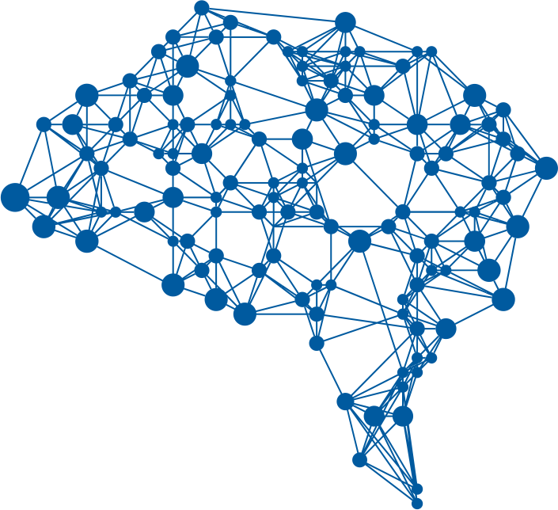
This time…
Neural Networks!
Notes:
https://i.pinimg.com/originals/30/5e/08/305e0877c1ade71c70fcd4484aef2d2d.png

Slide 7
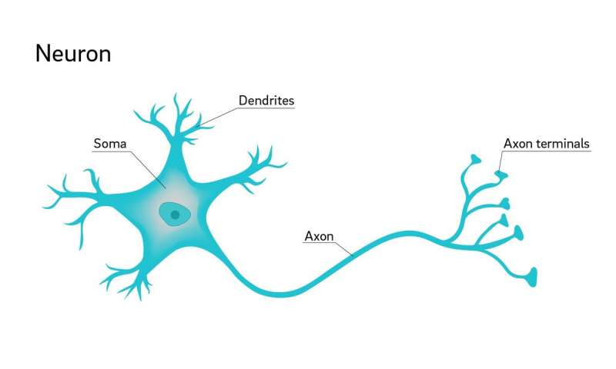

Interlude – the Neuron
Dendrites receive
electrical input from
other cells
Soma combines input,
produces output on axon
Axon connects to other
Neurons (@ dendrites)

Slide 8
Perceptrons – A Basic Approach
Decision Function
Data
Answer

Slide 9

Binary Perceptrons – Decision Functions
Binary AND
Binary OR
1 | X₁ | X₂ | Output
1 | 0 | 0
1 | 0 | 1
1 | 1 | 0
1 | 1 | 1
1 | X₁ | X₂ | Output
1 | 0 | 0
1 | 0 | 1
1 | 1 | 0
1 | 1 | 1

Slide 10
Binary Perceptrons – Decision Functions
Binary AND
Binary OR
1 | X₁ | X₂ | Output
1 | 0 | 0 | -1
1 | 0 | 1 | -1
1 | 1 | 0 | -1
1 | 1 | 1 | 1
1 | X₁ | X₂ | Output
1 | 0 | 0 | -1
1 | 0 | 1 | 1
1 | 1 | 0 | 1
1 | 1 | 1 | 1

Slide 11
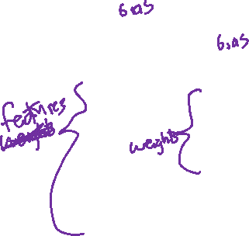
Perceptrons = Classifiers
X₀
W₀
Y₁
X₁
W₁
1 or -1
W₂
X₂

Slide 12
Binary Perceptrons – Decision Functions
Binary AND WEIGHTS DECISION FUNCTION
1 | X₁ | X₂ | Output
1 | 0 | 0 | -1
1 | 0 | 1 | -1
1 | 1 | 0 | -1
1 | 1 | 1 | 1
Y₁
X₁
W₁
1 or -1
W₂
X₂

Slide 13
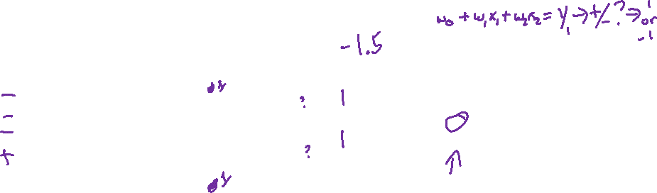
Binary Perceptrons – Decision Functions
Binary AND WEIGHTS
1
W₀
1 | X₁ | X₂ | Output
1 | 0 | 0 | -1
1 | 0 | 1 | -1
1 | 1 | 0 | -1
1 | 1 | 1 | 1
Y₁
+/-
X₁
W₁
1 or -1
W₂
X₂

Slide 14

Binary Perceptrons – Decision Functions
Binary OR
1
W₀
1 | X₁ | X₂ | Output
1 | 0 | 0 | -1
1 | 0 | 1 | 1
1 | 1 | 0 | 1
1 | 1 | 1 | 1
Y₁
X₁
W₁
1 or -1
W₂
X₂

Slide 15

Binary Perceptrons – Decision Functions
Binary NAND
1
W₀
1 | X₁ | X₂ | Output
1 | 0 | 0 | 1
1 | 0 | 1 | 1
1 | 1 | 0 | 1
1 | 1 | 1 | -1
Y₁
X₁
W₁
1 or -1
W₂
X₂

Slide 16
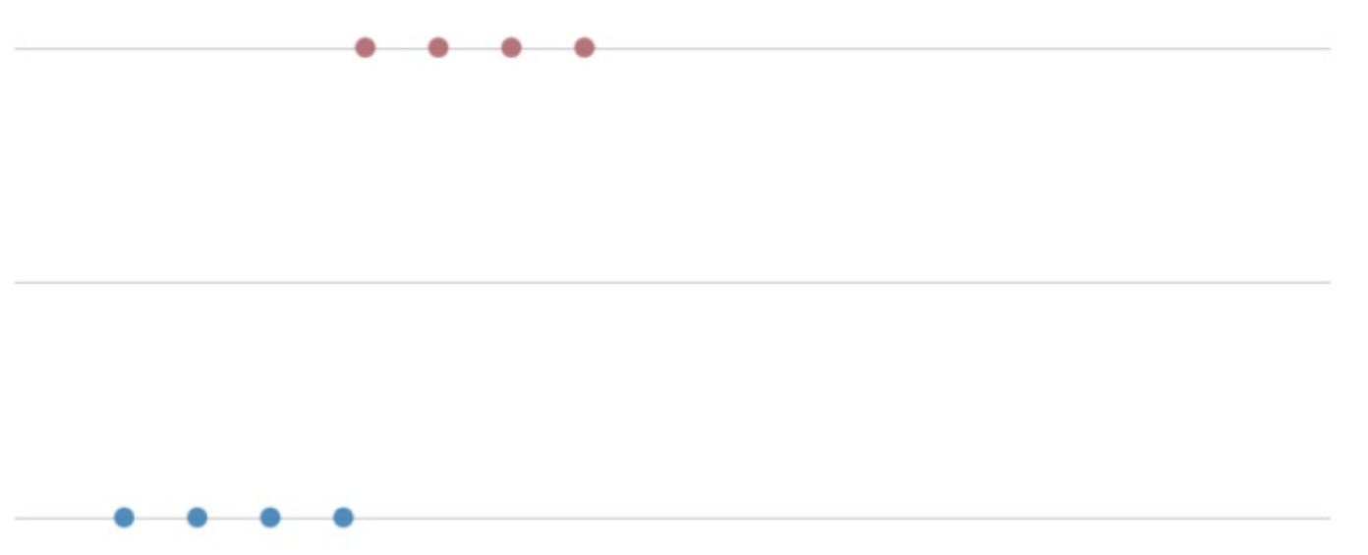

Perceptron – Week 2
1 – Bulldog
0 - ~Bulldog
Slobber (ml)
Perceptron if x > 50 ml, y = 1
else, y = 0

Slide 17
Binary Perceptrons – Decision Functions
Binary XOR
1
W₀
1 | X₁ | X₂ | Output
1 | 0 | 0 | -1
1 | 0 | 1 | 1
1 | 1 | 0 | 1
1 | 1 | 1 | -1
Y₁
X₁
W₁
1 or -1
W₂
X₂

Slide 18
Binary Perceptrons – Why Can’t we do XOR?

Slide 19
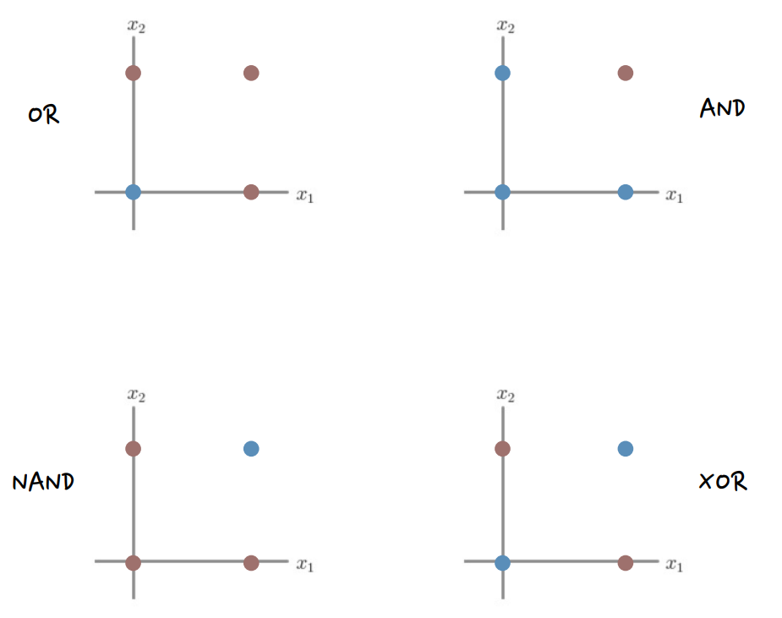

Binary Perceptrons – Why Can’t we do XOR?

Slide 20
Solving our XOR Problem – Multiple Perceptrons
OR Perceptron NAND Perceptron
1
1
0
1.5
Y₁
Y₂
X₁
1
X₁
-1
1 or -1
1 or -1
1
-1
X₂
X₂

Slide 21
Combining Multiple Perceptrons
OR Perceptron NAND Perceptron
1
1
0
1.5
Y₁
Y₂
X₁
1
X₁
-1
1 or -1
1 or -1
1
-1
X₂
X₂

Slide 22
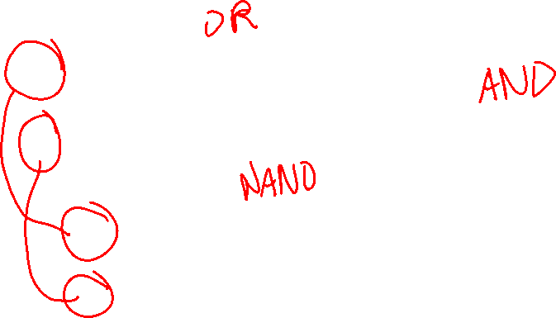
Combining Multiple Perceptrons
1
-0.5
Y₁
X₁
1
1
Y₃
X₂
1 or -1
1
1.5
Y₂
X₁
-1
-1
X₂

Slide 23
Combining Multiple Perceptrons
1
-0.5
A₁
OR
1
1
Y₃
X₁
1 or -1
1.5
-1
A₂ NAND
X₂
-1

Slide 24
Combining Multiple Perceptrons
1
1
-0.5
A₁
OR
1
-1.5
1
Y₃
AND
X₁
1
1 or -1
1.5
1
-1
A₂ NAND
X₂
-1

Slide 25
The Multi-layer Perceptron
INPUT LAYER HIDDEN LAYER OUTPUT LAYER
1
1
A₁
Y₁
X₁
1 or -1
A₂
X₂

Slide 26
The Multi-layer Perceptron
INPUT LAYER HIDDEN LAYER OUTPUT LAYER
1
1
$$b_{1}^{1}$$
$$b_{1}^{2}$$
A₁
Y₁
X₁
$$w_{11}^{1}$$
$$w_{11}^{2}$$
1 or -1
$$w_{21}^{1}$$
$$w_{21}^{2}$$
$$b_{2}^{1}$$
$$w_{12}^{1}$$
A₂
X₂
$$w_{22}^{1}$$

Slide 27
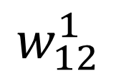
The Multi-layer Perceptron
Layer
$$w_{12}^{1}$$
Output
Input
INPUT LAYER HIDDEN LAYER OUTPUT LAYER
1
1
$$b_{1}^{1}$$
$$b_{1}^{2}$$
A₁
Y₁
X₁
$$w_{11}^{1}$$
$$w_{11}^{2}$$
1 or -1
$$w_{21}^{1}$$
$$w_{21}^{2}$$
$$b_{2}^{1}$$
$$w_{12}^{1}$$
A₂
X₂
$$w_{22}^{1}$$

Slide 28
The Multi-layer Perceptron
INPUT LAYER HIDDEN LAYER OUTPUT LAYER
Intermediate Activities z
$$z_{1}=w_{11}^{1}x_{1}+w_{21}^{1}x_{2}+b_{1}^{1}$$
$$z_{2}=w_{12}^{1}x_{1}+w_{22}^{1}x_{2}+b_{2}^{1}$$
Intermediate Activations a
1
1
$$b_{1}^{1}$$
$$b_{1}^{2}$$
a₁
Y₁
X₁
$$w_{11}^{1}$$
$$w_{11}^{2}$$
1 or -1
$$w_{21}^{1}$$
$$w_{21}^{2}$$
$$b_{2}^{1}$$
$$w_{12}^{1}$$
a₂
X₂
$$w_{22}^{1}$$

Slide 29
The Multi-layer Perceptron
INPUT LAYER HIDDEN LAYER OUTPUT LAYER
$$W^{1}=\left[\begin{matrix}w_{11}^{1} & w_{12}^{1} \\ w_{21}^{1} & w_{22}^{1}\end{matrix}\right], b^{1}=\left[\begin{matrix}b_{1}^{1} \\ b_{2}^{1}\end{matrix}\right]$$
Intermediate Activities z
$$z^{2}=W^{1}x^{1}+b^{1}$$
Intermediate Activations a
1
1
$$b_{1}^{1}$$
$$b_{1}^{2}$$
a₁
Y₁
X₁
$$w_{11}^{1}$$
$$w_{11}^{2}$$
1 or -1
$$w_{21}^{1}$$
$$w_{21}^{2}$$
$$b_{2}^{1}$$
$$w_{12}^{1}$$
a₂
X₂
$$w_{22}^{1}$$

Slide 30
The Multi-layer Perceptron
INPUT LAYER HIDDEN LAYER OUTPUT LAYER
$$W^{2}=\left[\begin{matrix}w_{11}^{2} & w_{21}^{2}\end{matrix}\right], b^{1}=\left[b_{1}^{2}\right]$$
Intermediate Activities z
$$z^{3}=W^{2}a^{2}+b^{2}$$
Final Activations y
+ / -
1
1
$$b_{1}^{1}$$
$$b_{1}^{2}$$
a₁
Y₁
X₁
$$w_{11}^{1}$$
$$w_{11}^{2}$$
1 or -1
$$w_{21}^{1}$$
$$w_{21}^{2}$$
$$b_{2}^{1}$$
$$w_{12}^{1}$$
a₂
X₂
$$w_{22}^{1}$$

Slide 31
Combining Multiple Perceptrons
1
1
$$W^{1}=\left[\begin{matrix}w_{11}^{1} & w_{12}^{1} \\ w_{21}^{1} & w_{22}^{1}\end{matrix}\right], b^{1}=\left[\begin{matrix}b_{1}^{1} \\ b_{2}^{1}\end{matrix}\right]$$
Intermediate Activities z
$$z^{2}=W^{1}x^{1}+b^{1}$$
Intermediate Activations a
0
A₁
OR
1
-1.5
1
Y₃
AND
X₁
1
1 or -1
1.5
1
-1
A₂ NAND
X₂
-1

Slide 32
Combining Multiple Perceptrons
1
1
$$W^{2}=\left[\begin{matrix}w_{11}^{2} & w_{11}^{2}\end{matrix}\right], b^{1}=\left[b_{1}^{2}\right]$$
Intermediate Activities z
$$z^{3}=W^{2}a^{2}+b^{2}$$
Final Activations y
0
A₁
OR
1
-1.5
1
1
Y₃
AND
X₁
1 or -1
1.5
1
-1
A₂ NAND
X₂
-1

Slide 33
Generalizing Beyond The Perceptron
What comes in to a decision point?
How the decision point makes a decision?
What comes out of a decision point?

Slide 34
Adding & Removing Connections
INPUT LAYER HIDDEN LAYER OUTPUT LAYER
1
1
$$b_{1}^{1}$$
$$b_{1}^{2}$$
A₁
Y₁
X₁
$$w_{11}^{1}$$
$$w_{11}^{2}$$
1 or -1
$$w_{21}^{1}$$
$$w_{21}^{2}$$
$$b_{2}^{1}$$
$$w_{12}^{1}$$
A₂
X₂
$$w_{22}^{1}$$

Slide 35
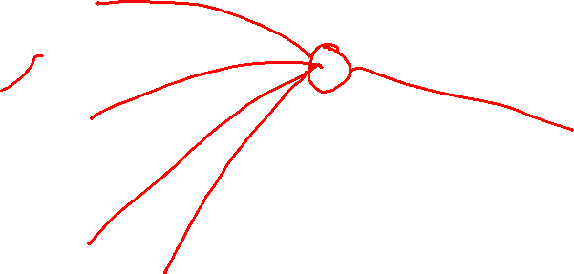
Adding & Removing Connections
INPUT LAYER HIDDEN LAYER OUTPUT LAYER
1
1
$$b_{1}^{1}$$
$$b_{1}^{2}$$
A₁
Y₁
X₁
$$w_{11}^{1}$$
$$w_{11}^{2}$$
1 or -1
$$w_{21}^{1}$$
$$w_{21}^{2}$$
$$b_{2}^{1}$$
$$w_{12}^{1}$$
A₂
X₂
X₃
$$w_{22}^{1}$$

Slide 36
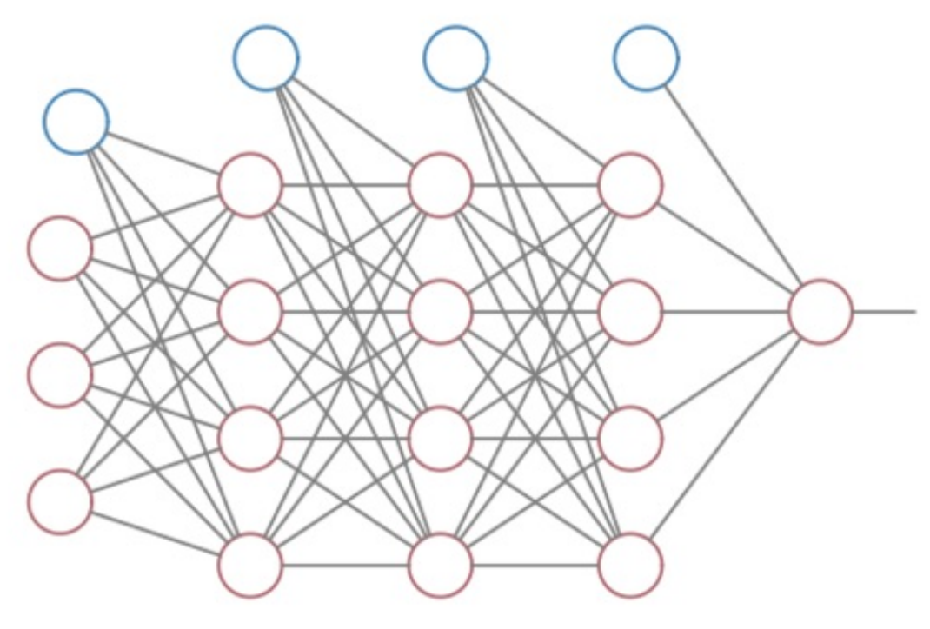

Neural Networks!
Data Input Layer
Hidden Layer(s)
Output Layer

Slide 37
Interlude – the Neuron
Dendrites receive
electrical input from
other cells
Soma combines input,
produces output on axon
Axon connects to other
Neurons (@ dendrites)

Slide 38
Neural Networks!
Data Input Layer
Hidden Layer(s)
Output Layer

Slide 39
Generalizing Beyond The Perceptron
What comes in to a decision point?
How the decision point makes a decision?
What comes out of a decision point?

Slide 40
Perceptron – Week 2
1 – Bulldog
0 - ~Bulldog
Slobber (ml)
Perceptron if x > 50 ml, y = 1
else, y = 0

Slide 41
Perceptron – Week 2
1 – Bulldog
0 - ~Bulldog
Slobber (ml)
Perceptron if x > 50 ml, y = 1
else, y = 0
1
$$−50$$
Y₁
X₁
1
1 or -1

Slide 42
Generalizing Beyond The Perceptron
What comes in to a decision point?
- any number of entries
- any possible values
How the decision point makes a decision?
What comes out of a decision point?

Slide 43
Perceptron – Outputs
1
$$−50$$
Y₁
X₁
1
1 or -1

Slide 44
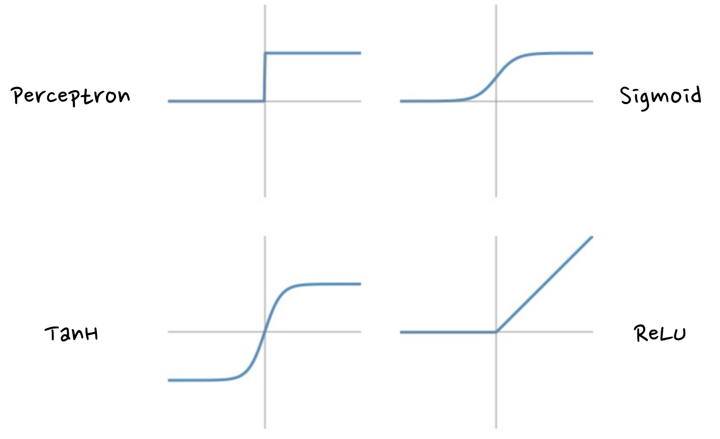
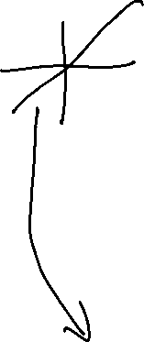
Decision Boundaries
Any decision
Function
ReLU – Rectified
linear unit,
Max(0,z)
TanH and ReLU
are in vogue

Slide 45
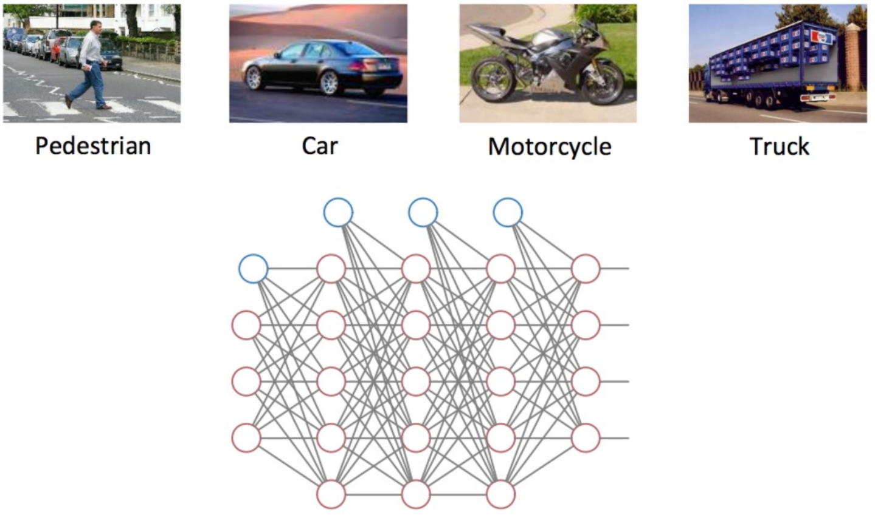
Neural Network Outputs – Beyond Binary

Slide 46

Neural Network Outputs – Beyond Binary

Slide 47
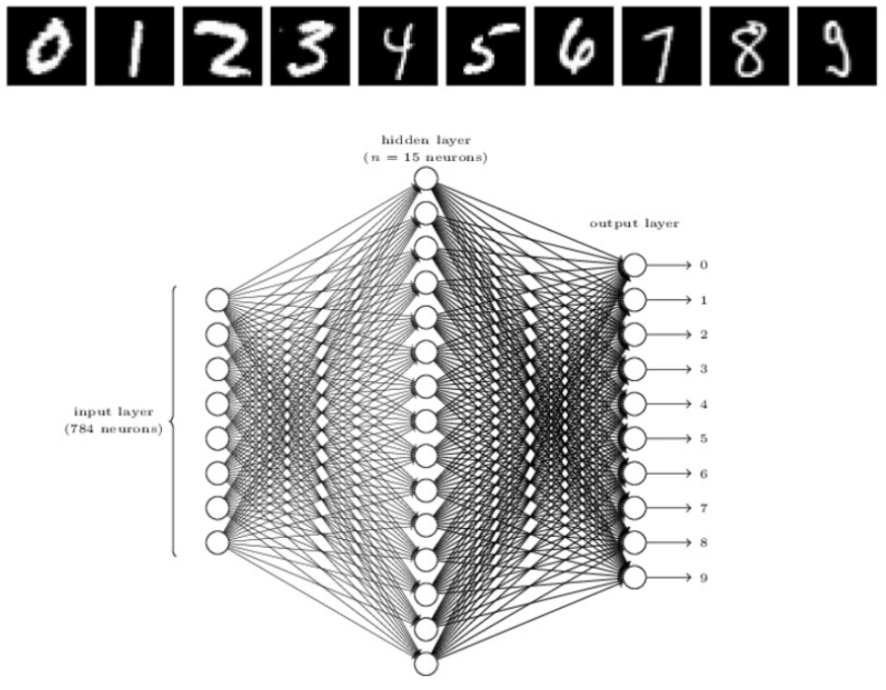
Neural Networks

Slide 48
Neural Networks!
Data Input Layer
Hidden Layer(s)
Output Layer

Slide 49
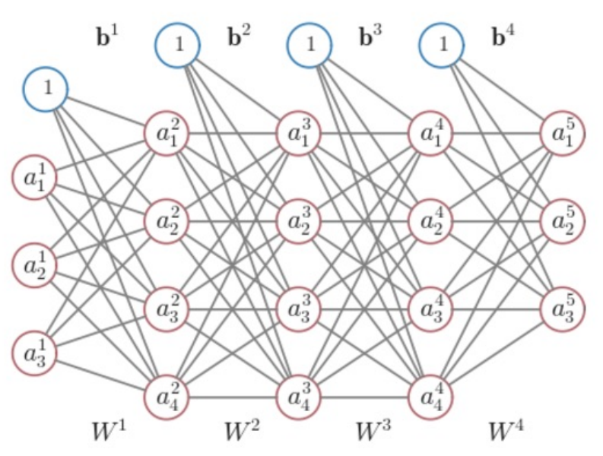
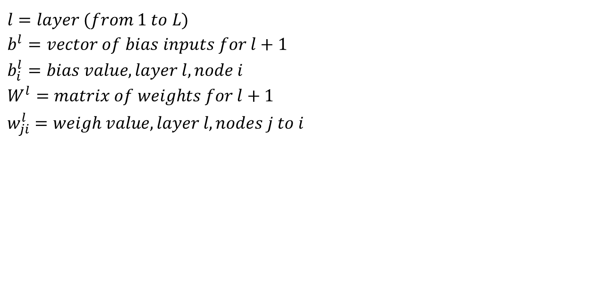
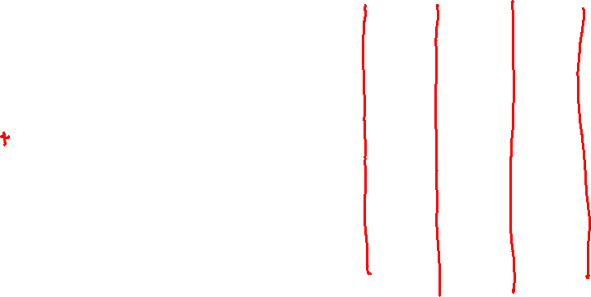
Neural Networks - Notation
$$l=layer (from 1 to L)$$
$$b^{l}=vector of bias inputs for l+1$$
$$b_{i}^{l}=bias value, layer l, node i$$
$$W^{l}=matrix of weights for l+1$$
$$w_{ji}^{l}=weigh value, layer l, nodes j to i$$

Slide 50
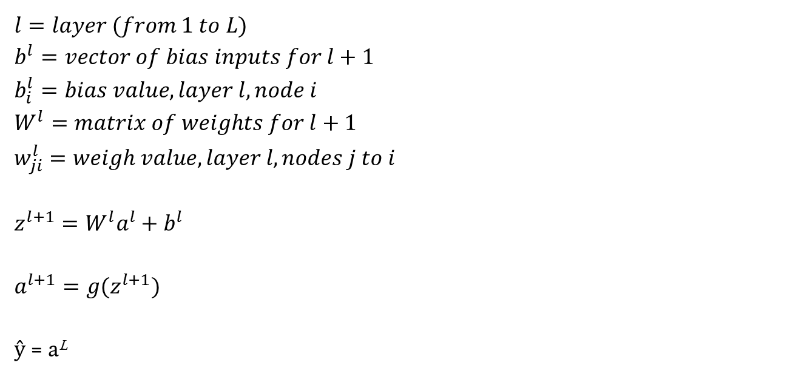
Neural Networks - Notation
$$l=layer (from 1 to L)$$
$$b^{l}=vector of bias inputs for l+1$$
$$b_{i}^{l}=bias value, layer l, node i$$
$$W^{l}=matrix of weights for l+1$$
$$w_{ji}^{l}=weigh value, layer l, nodes j to i$$
$$z^{l+1}=W^{l}a^{l}+b^{l}$$
$$a^{l+1}=g(z^{l+1})$$
ŷ = a^{L}

Slide 51
Neural Networks – Learning the Weights
Define a Loss Function $C\left(x,y,W,b\right)$
$$Classification=−\sum_{k=1}^{m}{y_{k}\log\left({\hat{y}}_{k}\right)+\left(1 −y_{k}\right)\log\left(1−{\hat{y}}_{k}\right)}$$
$$Regression=\frac{1}{2}\sum_{k=1}^{m}{{(y}_{k}−{\hat{y}}_{k})2}$$

Slide 52
Neural Networks – Learning the Weights
Gradient Descent!

Slide 53
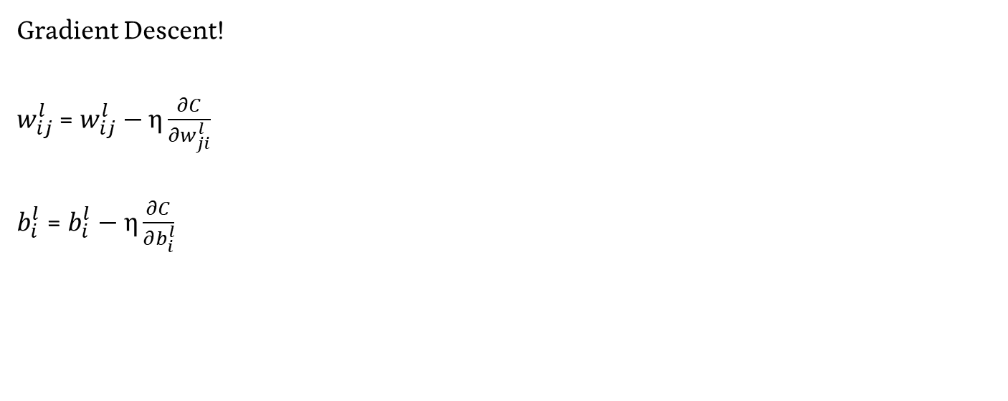
Neural Networks – Learning the Weights
Gradient Descent!
$w_{ij}^{l}$ = $w_{ij}^{l}−\text{η}\frac{∂C}{∂w_{ji}^{l}}$
$b_{i}^{l}$ = $b_{i}^{l}−\text{η}\frac{∂C}{∂b_{i}^{l}}$

Slide 54
Neural Networks – Learning the Weights
Gradient Descent!
$w_{ij}^{l}$ = $w_{ij}^{l}−\text{η}\frac{∂C}{∂w_{ji}^{l}}$
$b_{i}^{l}$ = $b_{i}^{l}−\text{η}\frac{∂C}{∂b_{i}^{l}}$

Slide 55
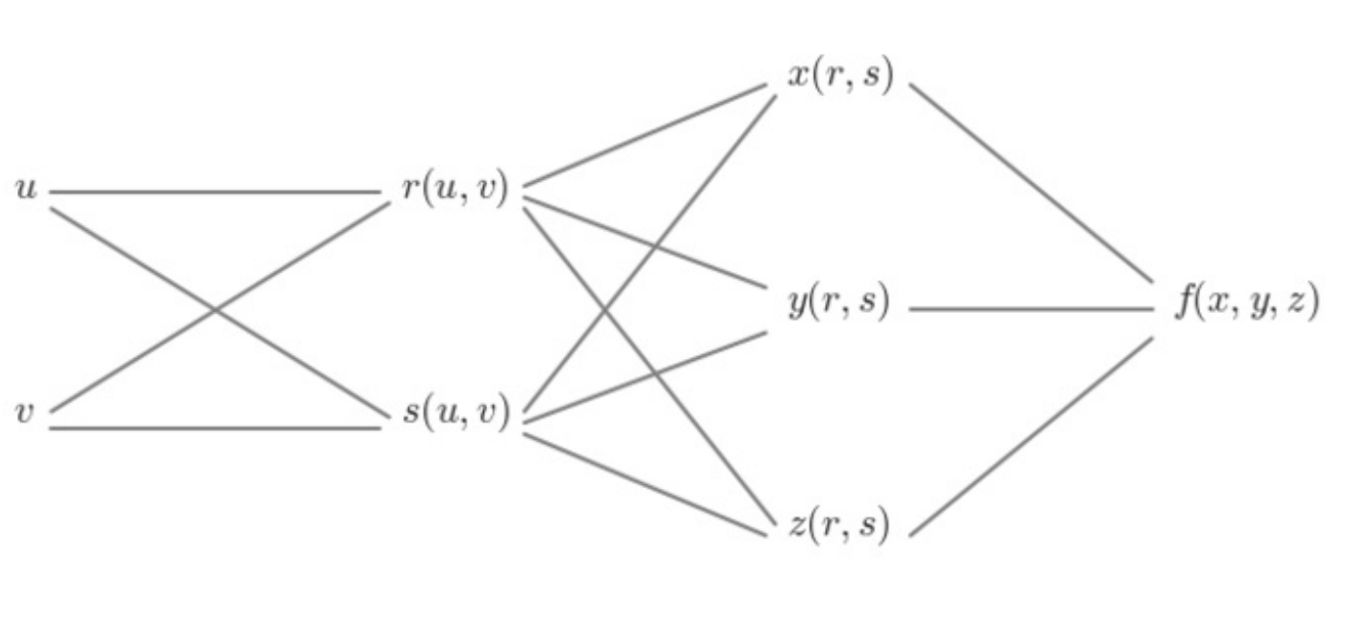
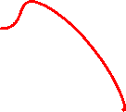
Computing the Partial Derivatives
$$derivative of f with respect to x= \frac{∂f}{∂x}$$

Slide 56
Computing the Partial Derivatives
$$derivative of f with respect to y= \frac{∂f}{∂y}$$

Slide 57
Computing the Partial Derivatives
$$derivative of f with respect to z= \frac{∂f}{∂z}$$

Slide 58
Computing the Partial Derivatives
$$derivative of f with respect to r=???$$

Slide 59
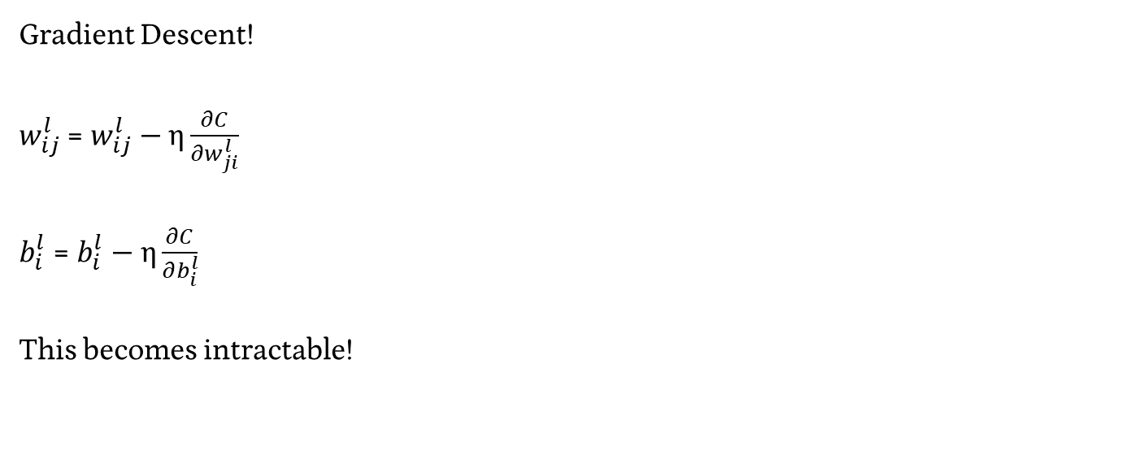
Neural Networks – Learning the Weights
Gradient Descent!
$w_{ij}^{l}$ = $w_{ij}^{l}−\text{η}\frac{∂C}{∂w_{ji}^{l}}$
$b_{i}^{l}$ = $b_{i}^{l}−\text{η}\frac{∂C}{∂b_{i}^{l}}$
This becomes intractable!

Slide 60
Overcoming Gradient Descent Problems
Resolving derivatives of nested functions using The Chain Rule

Slide 61
Overcoming Gradient Descent Problems
Resolving derivatives of nested functions using The Chain Rule
The Chain Rule (Calculus ???)
$$\frac{d}{dx}f\left(g\left(x\right)\right)=f^{′}\left(g\left(x\right)\right)g^{′}\left(x\right)= \frac{df}{dg}\frac{dg}{dx}$$

Slide 62
Computing the Partial Derivatives
$$derivative of f with respect to r=???$$

Slide 63
Computing the Partial Derivatives
$$derivative of f with respect to r=???$$
$$\frac{∂f}{∂r}=\frac{∂f}{∂x}\frac{∂x}{∂r}+\frac{∂f}{∂y}\frac{∂y}{∂r}+\frac{∂f}{∂z}\frac{∂z}{∂r}$$

Slide 64
Computing the Partial Derivatives
$$derivative of f with respect to s=???$$

Slide 65
Computing the Partial Derivatives
$$derivative of f with respect to s=???$$
$$\frac{∂f}{∂s}=\frac{∂f}{∂x}\frac{∂x}{∂s}+\frac{∂f}{∂y}\frac{∂y}{∂s}+\frac{∂f}{∂z}\frac{∂z}{∂s}$$

Slide 66
Computing the Partial Derivatives - Practice
$$derivative of f with respect to s=\frac{∂f}{∂s}=\frac{∂f}{∂x}\frac{∂x}{∂s}+\frac{∂f}{∂y}\frac{∂y}{∂s}+\frac{∂f}{∂z}\frac{∂z}{∂s}$$
Given…
$$f=xyz$$
$$x=r$$
$$y=rs$$
$$z=s$$
$$\frac{∂f}{∂s}= ?$$

Slide 67
Computing the Partial Derivatives - Practice
$$derivative of f with respect to s=\frac{∂f}{∂s}=\frac{∂f}{∂x}\frac{∂x}{∂s}+\frac{∂f}{∂y}\frac{∂y}{∂s}+\frac{∂f}{∂z}\frac{∂z}{∂s}$$
Given…
$$f=xyz$$
$$x=r$$
$$y=rs$$
$$z=s$$
$$\frac{∂f}{∂s}=yz∗0+xz ∗r+xy ∗1$$

Slide 68
Computing the Partial Derivatives - Practice
$$derivative of f with respect to s=\frac{∂f}{∂s}=\frac{∂f}{∂x}\frac{∂x}{∂s}+\frac{∂f}{∂y}\frac{∂y}{∂s}+\frac{∂f}{∂z}\frac{∂z}{∂s}$$
Given…
$$f=xyz$$
$$x=r$$
$$y=rs$$
$$z=s$$
$$\frac{∂f}{∂s}=yz∗0+xz ∗r+xy ∗1$$

Slide 69
Computing the Partial Derivatives - Practice
$$derivative of f with respect to s=\frac{∂f}{∂s}=\frac{∂f}{∂x}\frac{∂x}{∂s}+\frac{∂f}{∂y}\frac{∂y}{∂s}+\frac{∂f}{∂z}\frac{∂z}{∂s}$$
$$f=xyz$$
$$x=r$$
$$y=rs$$
$$z=s$$
$$\frac{∂f}{∂s}=yz∗0+xz∗r+xy ∗1$$

Slide 70
Computing the Partial Derivatives - Practice
$$derivative of f with respect to s=\frac{∂f}{∂s}=\frac{∂f}{∂x}\frac{∂x}{∂s}+\frac{∂f}{∂y}\frac{∂y}{∂s}+\frac{∂f}{∂z}\frac{∂z}{∂s}$$
$$f=xyz$$
$$x=r$$
$$y=rs$$
$$z=s$$
$$\frac{∂f}{∂s}=yz∗0+xz∗r+xy ∗1$$
$$\frac{∂f}{∂s}=rs^{2}∗0+rs∗r+r^{2}s ∗1$$

Slide 71
Computing the Partial Derivatives - Practice
$$derivative of f with respect to s=\frac{∂f}{∂s}=\frac{∂f}{∂x}\frac{∂x}{∂s}+\frac{∂f}{∂y}\frac{∂y}{∂s}+\frac{∂f}{∂z}\frac{∂z}{∂s}$$
$$f=xyz$$
$$x=r$$
$$y=rs$$
$$z=s$$
$$\frac{∂f}{∂s}=yz∗0+xz∗r+xy ∗1$$
$$\frac{∂f}{∂s}=rs^{2}∗0+rs∗r+r^{2}s ∗1$$
$$\frac{∂f}{∂s}=2r^{2}s$$

Slide 72
Computing the Partial Derivatives - Practice
$$derivative of f with respect to s=\frac{∂f}{∂s}=\frac{∂f}{∂x}\frac{∂x}{∂s}+\frac{∂f}{∂y}\frac{∂y}{∂s}+\frac{∂f}{∂z}\frac{∂z}{∂s}$$
$$f=xyz$$
$$x=r$$
$$y=rs$$
$$z=s$$
$$f\left(r,s\right)=r ∗rs ∗s=r^{2}s^{2}$$
$$\frac{∂f}{∂s}=2r^{2}s$$

Slide 73
Computing the Partial Derivatives
$$derivative of f with respect to u=???$$

Slide 74
Computing the Partial Derivatives
$$derivative of f with respect to u=$$
$$\frac{∂f}{∂x}\frac{∂x}{∂r}\frac{∂r}{∂u}+\frac{∂f}{∂y}\frac{∂y}{∂r}\frac{∂r}{∂u}+\frac{∂f}{∂z}\frac{∂z}{∂r}\frac{∂r}{∂u}+\frac{∂f}{∂x}\frac{∂x}{∂s}\frac{∂s}{∂u}+\frac{∂f}{∂y}\frac{∂y}{∂s}\frac{∂s}{∂u}+\frac{∂f}{∂z}\frac{∂z}{∂s}\frac{∂s}{∂u}$$

Slide 75
Computing the Partial Derivatives
$$derivative of f with respect to u=$$
$$\left(\frac{∂f}{∂x}\frac{∂x}{∂r}+\frac{∂f}{∂y}\frac{∂y}{∂r}+\frac{∂f}{∂z}\frac{∂z}{∂r}\right)\frac{∂r}{∂u}+\left(\frac{∂f}{∂x}\frac{∂x}{∂s}+\frac{∂f}{∂y}\frac{∂y}{∂s}+\frac{∂f}{∂z}\frac{∂z}{∂s}\right)\frac{∂s}{∂u}$$

Slide 76
Computing the Partial Derivatives
$$derivative of f with respect to u=$$
$$\frac{∂f}{∂r}\frac{∂r}{∂u}+\frac{∂f}{∂s}\frac{∂s}{∂u}$$

Slide 77
Computing the Partial Derivatives
Chain Rule
If you know the derivative in terms of an intermediate value, you can skip the items in-between!

Slide 78
Back Propagation
1
1
b¹
b²
Y₁
X₁
C(Y₁,Y₂)
Y₂
X₂
a¹
W¹
W²
z³|a³
z²|a²

Slide 79
Back Propagation
Derivatives of C w.r.t Weights, biases
$$\frac{∂C}{∂w_{ij}^{l}},\frac{∂C}{∂b_{i}^{l}}for l=1, 2$$
1
1
b¹
b²
Y₁
X₁
C(Y₁,Y₂)
Y₂
X₂
a¹
W¹
W²
z³|a³
z²|a²

Slide 80
Back Propagation
Derivatives of C w.r.t Weights, biases
Find our intermediate values (z^{l} or a^{l})
(z is going to work easier)
1
1
b¹
b²
Y₁
X₁
C(Y₁,Y₂)
Y₂
X₂
a¹
W¹
W²
z³|a³
z²|a²

Slide 81
Back Propagation
Derivatives of C w.r.t Weights, biases
$${\text{δ}}_{i}^{l}=\frac{∂C}{∂w_{ij}^{l}}, {\text{δ}}^{l} vector quantity$$
1
1
b¹
b²
Y₁
X₁
C(Y₁,Y₂)
Y₂
X₂
a¹
W¹
W²
z³|a³
z²|a²

Slide 82
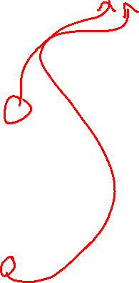
Back Propagation
$${\text{δ}}_{i}^{3}=\frac{∂C}{∂z_{i}^{3}}=\frac{∂C}{∂a_{i}^{3}}\frac{∂a_{i}^{3}}{∂z_{i}^{3}}$$
Where i = 1, 2
1
1
b¹
b²
Y₁
X₁
C(Y₁,Y₂)
Y₂
X₂
a¹
W¹
W²
z³|a³
z²|a²

Slide 83
Back Propagation
$${\text{δ}}_{i}^{3}=\frac{∂C}{∂z_{i}^{3}}=\frac{∂C}{∂a_{i}^{3}}\frac{∂a_{i}^{3}}{∂z_{i}^{3}}, i=1,2$$
Let’s clean this up

Slide 84
Decision Boundaries
Any decision
Function
ReLU – Rectified
linear unit,
Max(0,z)
TanH and ReLU
are in vogue

Slide 85
The Multi-layer Perceptron
INPUT LAYER HIDDEN LAYER OUTPUT LAYER
$$W^{1}=\left[\begin{matrix}w_{11}^{1} & w_{12}^{1} \\ w_{21}^{1} & w_{22}^{1}\end{matrix}\right], b^{1}=\left[\begin{matrix}b_{1}^{1} \\ b_{2}^{1}\end{matrix}\right]$$
Intermediate Activities z
$$z^{2}=W^{1}x^{1}+b^{1}$$
Intermediate Activations a
$$a^{2}=g(z^{2})$$
1
1
$$b_{1}^{1}$$
$$b_{1}^{2}$$
a₁
Y₁
X₁
$$w_{11}^{1}$$
$$w_{11}^{2}$$
1 or -1
$$w_{21}^{1}$$
$$w_{21}^{2}$$
$$b_{2}^{1}$$
$$w_{12}^{1}$$
a₂
X₂
$$w_{22}^{1}$$

Slide 86
Back Propagation
$${\text{δ}}_{i}^{3}=\frac{∂C}{∂z_{i}^{3}}=\frac{∂C}{∂a_{i}^{3}}\frac{∂a_{i}^{3}}{∂z_{i}^{3}}, i=1,2$$
$a_{i}^{3}=g(z_{i}^{3})$, so $\frac{∂a_{i}^{3}}{∂z_{i}^{3}}=g′(z_{i}^{3})$

Slide 87
Back Propagation
$${\text{δ}}_{i}^{3}=\frac{∂C}{∂z_{i}^{3}}=\frac{∂C}{∂a_{i}^{3}}\frac{∂a_{i}^{3}}{∂z_{i}^{3}}, i=1,2$$
$${\text{δ}}_{i}^{3}=\frac{∂C}{∂z_{i}^{3}}=\frac{∂C}{∂a_{i}^{3}}g′(z_{i}^{3}), i=1,2$$

Slide 88
Computing the Partial Derivatives
$$derivative of f with respect to x= \frac{∂f}{∂x}$$

Slide 89
Back Propagation
$${\text{δ}}_{i}^{3}=\frac{∂C}{∂z_{i}^{3}}=\frac{∂C}{∂a_{i}^{3}}\frac{∂a_{i}^{3}}{∂z_{i}^{3}}, i=1,2$$
$${\text{δ}}_{i}^{3}=\frac{∂C}{∂z_{i}^{3}}=\frac{∂C}{∂a_{i}^{3}}g′(z_{i}^{3}), i=1,2$$
First partial derivative is just w.r.t. our outputs for each node i
$${\text{▽}}_{a^{3}}\text{C}$$

Slide 90
Back Propagation
$${\text{δ}}_{i}^{3}=\frac{∂C}{∂z_{i}^{3}}=\frac{∂C}{∂a_{i}^{3}}\frac{∂a_{i}^{3}}{∂z_{i}^{3}}, i=1,2$$
$${\text{δ}}_{i}^{3}=\frac{∂C}{∂z_{i}^{3}}=\frac{∂C}{∂a_{i}^{3}}g′(z_{i}^{3}), i=1,2$$
$${\text{δ}}^{3}={\text{▽}}_{a^{3}}\text{C} \text{⊙} g′(z_{i}^{3})$$

Slide 91
Back Propagation
$${\text{δ}}^{3}={\text{▽}}_{a^{3}}\text{C} \text{⊙} g′(z_{i}^{3})$$
$g′(z_{i}^{3})$ = derivative of the activation function (applied element-wise to each incoming value in z³
$\text{⊙}$ = element-wise multiplication of vectors
Note: Valid if C, g() are differentiable (which is true for our activation functions)
We’re going to keep working with these symbolically
Note: We need our activations, intermediate activities a, z
We’re going to have to compute the values for our point for SGD

Slide 92
Computing delta in practice
Regression Problem, Sigmoid Activation Function
$C=\frac{1}{2}\sum_{k=1}^{m}{{(y}_{k}−{\hat{y}}_{k})2}$, $g\left(z\right)= sigmoid\left(z\right)$
$${\text{▽}}_{a^{3}}\text{C}\text{ ⊙} g′(z_{i}^{3})$$

Slide 93
Computing delta in practice
Regression Problem, Sigmoid Activation Function
$C=\frac{1}{2}\sum_{k=1}^{m}{{(y}_{k}−{\hat{y}}_{k})2}$, $g\left(z\right)= sigmoid(z)$
$$\frac{∂C}{∂a_{i}^{3}}= \frac{1}{2}{∗2∗(y}_{i}−a_{i}^{3}) ∗(−1)={(a_{i}^{3}−y}_{i})$$
$$g^{′}\left(z^{3}\right)=g\left(z_{i}^{3}\right)(1−g\left(z_{i}^{3}\right))$$
$${\text{δ}}^{3}={(a_{i}^{3}−y}_{i})\text{⊙} g(z_{i}^{3})\text{⊙}(1−g\left(z_{i}^{3}\right))$$

Slide 94
Back Propagation
Calculated ${\text{δ}}^{3}$ (delta vector for output layer)
$${\text{δ}}^{3}={\text{▽}}_{a^{3}}\text{C}\text{ ⊙} g′(z^{3})$$
But we need things in terms of weights and biases!
1
1
b¹
b²
Y₁
X₁
C(Y₁,Y₂)
Y₂
X₂
a¹
W¹
W²
z³|a³
z²|a²

Slide 95
The Multi-layer Perceptron
INPUT LAYER HIDDEN LAYER OUTPUT LAYER
$$W^{1}=\left[\begin{matrix}w_{11}^{1} & w_{12}^{1} \\ w_{21}^{1} & w_{22}^{1}\end{matrix}\right], b^{1}=\left[\begin{matrix}b_{1}^{1} \\ b_{2}^{1}\end{matrix}\right]$$
Intermediate Activities z
$$z^{2}=W^{1}x^{1}+b^{1}$$
Intermediate Activations a
$$a^{2}=g(z^{2})$$
1
1
$$b_{1}^{1}$$
$$b_{1}^{2}$$
a₁
Y₁
X₁
$$w_{11}^{1}$$
$$w_{11}^{2}$$
1 or -1
$$w_{21}^{1}$$
$$w_{21}^{2}$$
$$b_{2}^{1}$$
$$w_{12}^{1}$$
a₂
X₂
$$w_{22}^{1}$$

Slide 96
Computing delta in practice
$$\frac{∂C}{∂w_{21}^{2}}=$$

Slide 97
Computing delta in practice
$$\frac{∂C}{∂w_{21}^{2}}=\frac{∂C}{∂z_{2}^{3}}\frac{∂z_{2}^{3}}{∂w_{21}^{2}}={\text{δ}}_{2}^{3}\frac{∂z_{2}^{3}}{∂w_{21}^{2}}$$

Slide 98
Back Propagation
1
1
$$W^{1}=\left[\begin{matrix}w_{11}^{1} & w_{12}^{1} \\ w_{21}^{1} & w_{22}^{1}\end{matrix}\right], b^{1}=\left[\begin{matrix}b_{1}^{1} \\ b_{2}^{1}\end{matrix}\right]$$
Intermediate Activities z
$$z^{2}=W^{1}a^{1}+b^{1}$$
Intermediate Activations a
$$a^{2}=g(z^{2})$$
b¹
b²
Y₁
X₁
C(Y₁,Y₂)
Y₂
X₂
a¹
W¹
W²
z³|a³
z²|a²

Slide 99
Computing delta in practice
$$\frac{∂C}{∂w_{21}^{2}}=\frac{∂C}{∂z_{2}^{3}}\frac{∂z_{2}^{3}}{∂w_{21}^{2}}={\text{δ}}_{2}^{3}\frac{∂z_{2}^{3}}{∂w_{21}^{2}}$$
$$z^{3}=W^{2}a^{2}+ b^{2}$$
$$z_{2}^{3}=w_{21}^{2}a_{1}^{2}+w_{22}^{2}a_{2}^{2}+w_{23}^{2}a_{3}^{2}+b_{2}^{2}$$

Slide 100
Computing delta in practice
$$\frac{∂C}{∂w_{21}^{2}}=\frac{∂C}{∂z_{2}^{3}}\frac{∂z_{2}^{3}}{∂w_{21}^{2}}={\text{δ}}_{2}^{3}\frac{∂z_{2}^{3}}{∂w_{21}^{2}}$$
$$z^{3}=W^{2}a^{2}+ b^{2}$$
$$z_{2}^{3}=w_{21}^{2}a_{1}^{2}+w_{22}^{2}a_{2}^{2}+w_{23}^{2}a_{3}^{2}+b_{2}^{2}$$

Slide 101
Computing delta in practice
$$\frac{∂C}{∂w_{21}^{2}}=\frac{∂C}{∂z_{2}^{3}}\frac{∂z_{2}^{3}}{∂w_{21}^{2}}={\text{δ}}_{2}^{3}\frac{∂z_{2}^{3}}{∂w_{21}^{2}}$$
$$z^{3}=W^{2}a^{2}+ b^{2}$$
$$z_{2}^{3}=w_{21}^{2}a_{1}^{2}+w_{22}^{2}a_{2}^{2}+w_{23}^{2}a_{3}^{2}+b_{2}^{2}$$
$$\frac{∂z_{2}^{3}}{∂w_{21}^{2}}=a_{1}^{2}$$

Slide 102
Computing delta in practice
$$\frac{∂C}{∂w_{21}^{2}}=\frac{∂C}{∂z_{2}^{3}}\frac{∂z_{2}^{3}}{∂w_{21}^{2}}={\text{δ}}_{2}^{3}a_{1}^{2}$$
$$\frac{∂C}{∂w_{ij}^{2}}=\frac{∂C}{∂z_{i}^{3}}\frac{∂z_{i}^{3}}{∂w_{ij}^{2}}={\text{δ}}_{i}^{3}a_{j}^{2}$$
For i =1, 2; j = 1, 2, 3

Slide 103
Back Propagation
$$\frac{∂C}{∂w_{ij}^{2}}=\frac{∂C}{∂z_{i}^{3}}\frac{∂z_{i}^{3}}{∂w_{ij}^{2}}={\text{δ}}_{i}^{3}a_{j}^{2}$$
For i = 1, 2; j = 1, 2, 3
1
1
b¹
b²
Y₁
X₁
C(Y₁,Y₂)
Y₂
X₂
a¹
W¹
W²
z³|a³
z²|a²

Slide 104
Back Propagation
$$\frac{∂C}{∂w_{ij}^{2}}=\frac{∂C}{∂z_{i}^{3}}\frac{∂z_{i}^{3}}{∂w_{ij}^{2}}={\text{δ}}_{i}^{3}a_{j}^{2}$$
For i = 1, 2; j = 1, 2, 3
$$W^{2}=\left[\begin{matrix}w_{11}^{2} & w_{12}^{2} & w_{13}^{2} \\ w_{21}^{2} & w_{22}^{2} & w_{23}^{2}\end{matrix}\right]$$
1
1
b¹
b²
Y₁
X₁
C(Y₁,Y₂)
Y₂
X₂
a¹
W¹
W²
z³|a³
z²|a²

Slide 105
Back Propagation
$$\frac{∂C}{∂w_{ij}^{2}}=\frac{∂C}{∂z_{i}^{3}}\frac{∂z_{i}^{3}}{∂w_{ij}^{2}}={\text{δ}}_{i}^{3}a_{j}^{2}$$
For i = 1, 2; j = 1, 2, 3
$$W^{2}=\left[\begin{matrix}w_{11}^{2} & w_{12}^{2} & w_{13}^{2} \\ w_{21}^{2} & w_{22}^{2} & w_{23}^{2}\end{matrix}\right]$$
$$\frac{∂C}{∂w^{2}}=\left[\begin{matrix}\frac{∂C}{∂w_{11}^{2}} & \frac{∂C}{∂w_{12}^{2}} & \frac{∂C}{∂w_{13}^{2}} \\ \frac{∂C}{∂w_{21}^{2}} & \frac{∂C}{∂w_{22}^{2}} & \frac{∂C}{∂w_{23}^{2}}\end{matrix}\right]$$
1
1
b¹
b²
Y₁
X₁
C(Y₁,Y₂)
Y₂
X₂
a¹
W¹
W²
z³|a³
z²|a²

Slide 106
Back Propagation
$$\frac{∂C}{∂w_{ij}^{2}}=\frac{∂C}{∂z_{i}^{3}}\frac{∂z_{i}^{3}}{∂w_{ij}^{2}}={\text{δ}}_{i}^{3}a_{j}^{2}$$
For i = 1, 2; j = 1, 2, 3
$$W^{2}=\left[\begin{matrix}w_{11}^{2} & w_{12}^{2} & w_{13}^{2} \\ w_{21}^{2} & w_{22}^{2} & w_{23}^{2}\end{matrix}\right]$$
$$\frac{∂C}{∂w^{2}}=\left[\begin{matrix}\frac{∂C}{∂w_{11}^{2}} & \frac{∂C}{∂w_{12}^{2}} & \frac{∂C}{∂w_{13}^{2}} \\ \frac{∂C}{∂w_{21}^{2}} & \frac{∂C}{∂w_{22}^{2}} & \frac{∂C}{∂w_{23}^{2}}\end{matrix}\right]$$
$$\frac{∂C}{∂w^{2}}=\left[\begin{matrix}{\text{δ}}_{1}^{3}a_{1}^{2} & {\text{δ}}_{1}^{3}a_{2}^{2} & {\text{δ}}_{1}^{3}a_{3}^{2} \\ {\text{δ}}_{2}^{3}a_{1}^{2} & {\text{δ}}_{2}^{3}a_{2}^{2} & {\text{δ}}_{2}^{3}a_{3}^{2}\end{matrix}\right]$$
1
1
b¹
b²
Y₁
X₁
C(Y₁,Y₂)
Y₂
X₂
a¹
W¹
W²
z³|a³
z²|a²

Slide 107
Back Propagation
$$\frac{∂C}{∂w_{ij}^{2}}=\frac{∂C}{∂z_{i}^{3}}\frac{∂z_{i}^{3}}{∂w_{ij}^{2}}={\text{δ}}_{i}^{3}a_{j}^{2}$$
For i = 1, 2; j = 1, 2, 3
$$W^{2}=\left[\begin{matrix}w_{11}^{2} & w_{12}^{2} & w_{13}^{2} \\ w_{21}^{2} & w_{22}^{2} & w_{23}^{2}\end{matrix}\right]$$
$$\frac{∂C}{∂w^{2}}=\left[\begin{matrix}\frac{∂C}{∂w_{11}^{2}} & \frac{∂C}{∂w_{12}^{2}} & \frac{∂C}{∂w_{13}^{2}} \\ \frac{∂C}{∂w_{21}^{2}} & \frac{∂C}{∂w_{22}^{2}} & \frac{∂C}{∂w_{23}^{2}}\end{matrix}\right]$$
$$\frac{∂C}{∂w^{2}}=\left[\begin{matrix}{\text{δ}}_{1}^{3}a_{1}^{2} & {\text{δ}}_{1}^{3}a_{2}^{2} & {\text{δ}}_{1}^{3}a_{3}^{2} \\ {\text{δ}}_{2}^{3}a_{1}^{2} & {\text{δ}}_{2}^{3}a_{2}^{2} & {\text{δ}}_{2}^{3}a_{3}^{2}\end{matrix}\right]$$
$$\frac{∂C}{∂w^{2}}={\text{δ}}^{3}{{(a}^{2})}^{T}$$
1
1
b¹
b²
Y₁
X₁
C(Y₁,Y₂)
Y₂
X₂
a¹
W¹
W²
z³|a³
z²|a²

Slide 108
Back Propagation
$$\frac{∂C}{∂w^{2}}={\text{δ}}^{3}{{(a}^{2})}^{T}$$
The derivatives of C for each weight are found in our matrix!
But we also have derivatives of C for each bias term…
1
1
b¹
b²
Y₁
X₁
C(Y₁,Y₂)
Y₂
X₂
a¹
W¹
W²
z³|a³
z²|a²

Slide 109
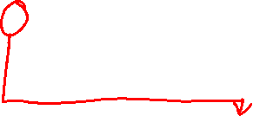
Computing delta in practice
$$\frac{∂C}{∂b_{1}^{2}}=\frac{∂C}{∂z_{1}^{3}}\frac{∂z_{1}^{3}}{∂b_{1}^{2}}={\text{δ}}_{2}^{3}\frac{∂z_{1}^{3}}{∂b_{1}^{2}}$$
$$z^{3}=W^{2}a^{2}+ b^{2}$$
$$z_{1}^{3}=w_{11}^{2}a_{1}^{2}+w_{12}^{2}a_{2}^{2}+w_{13}^{2}a_{3}^{2}+b_{1}^{2}$$

Slide 110
Computing delta in practice
$$\frac{∂C}{∂b_{1}^{2}}=\frac{∂C}{∂z_{1}^{3}}\frac{∂z_{1}^{3}}{∂b_{1}^{2}}={\text{δ}}_{2}^{3}\frac{∂z_{1}^{3}}{∂b_{1}^{2}}$$
$$z^{3}=W^{2}a^{2}+ b^{2}$$
$$z_{1}^{3}=w_{11}^{2}a_{1}^{2}+w_{12}^{2}a_{2}^{2}+w_{13}^{2}a_{3}^{2}+b_{1}^{2}$$
$$\frac{∂z_{1}^{3}}{∂b_{1}^{2}}=1$$

Slide 111
Computing delta in practice
$$\frac{∂C}{∂b_{1}^{2}}=\frac{∂C}{∂z_{1}^{3}}\frac{∂z_{1}^{3}}{∂b_{1}^{2}}={\text{δ}}_{2}^{3}\frac{∂z_{1}^{3}}{∂b_{1}^{2}}$$
$$z^{3}=W^{2}a^{2}+ b^{2}$$
$$z_{1}^{3}=w_{11}^{2}a_{1}^{2}+w_{12}^{2}a_{2}^{2}+w_{13}^{2}a_{3}^{2}+b_{1}^{2}$$
$$\frac{∂z_{1}^{3}}{∂b_{1}^{2}}=1$$
$$\frac{∂C}{∂b_{1}^{2}}=\frac{∂C}{∂z_{1}^{3}}\frac{∂z_{1}^{3}}{∂b_{1}^{2}}={\text{δ}}_{1}^{3}∗1$$

Slide 112
Computing delta in practice
$$\frac{∂C}{∂b_{1}^{2}}=\frac{∂C}{∂z_{1}^{3}}\frac{∂z_{1}^{3}}{∂b_{1}^{2}}={\text{δ}}_{1}^{3}∗1$$
$$\frac{∂C}{∂b_{i}^{2}}=\frac{∂C}{∂z_{i}^{3}}\frac{∂z_{i}^{3}}{∂b_{i}^{2}}={\text{δ}}_{i}^{3}$$
$$\frac{∂C}{∂b^{2}}={\text{δ}}^{3}$$

Slide 113
Back Propagation So Far…
For a training example x_{k}
propagate forward to get activity vector z_{l} and activation vector a_{l} for each layer
To get the derivatives our final layer, we calculate
${\text{δ}}^{3}={\text{▽}}_{a^{3}}\text{C}\text{ ⊙} g′(z_{i}^{3})$
$\frac{∂C}{∂w^{2}}={\text{δ}}^{3}{{(a}^{2})}^{T}$
$\frac{∂C}{∂b^{2}}={\text{δ}}^{3}$

Slide 114

Back Propagation
$${\text{δ}}^{3}={\text{▽}}_{a^{3}}\text{C}\text{ ⊙} g′(z_{i}^{3})$$
$$\frac{∂C}{∂w^{2}}={\text{δ}}^{3}{{(a}^{2})}^{T}$$
$$\frac{∂C}{∂b^{2}}={\text{δ}}^{3}$$
We’ve got the derivatives for our last layer (layer 3).
But what do we need for the previous layer (layer 2)?
1
1
b¹
b²
Y₁
X₁
C(Y₁,Y₂)
Y₂
X₂
a¹
W¹
W²
z³|a³
z²|a²

Slide 115
Back Propagation
$${\text{δ}}^{3}={\text{▽}}_{a^{3}}\text{C}\text{ ⊙} g′(z_{i}^{3})$$
$$\frac{∂C}{∂w^{2}}={\text{δ}}^{3}{{(a}^{2})}^{T}$$
$$\frac{∂C}{∂b^{2}}={\text{δ}}^{3}$$
We’ve got the derivatives for our last layer (layer 3).
But what do we need for the previous layer (layer 2)?
${\text{δ}}^{2}$ would be nice…
1
1
b¹
b²
Y₁
X₁
C(Y₁,Y₂)
Y₂
X₂
a¹
W¹
W²
z³|a³
z²|a²

Slide 116
Back Propagation
$${\text{δ}}^{3}={\text{▽}}_{a^{3}}\text{C}\text{ ⊙} g′(z_{i}^{3})$$
$$\frac{∂C}{∂w^{2}}={\text{δ}}^{3}{{(a}^{2})}^{T}$$
$$\frac{∂C}{∂b^{2}}={\text{δ}}^{3}$$
We’ve got the derivatives for our last layer (layer 3).
But what do we need for the previous layer (layer 2)?
${\text{δ}}^{2}$ would be nice…
But the relationship between C and z² is complicated by our activation functions…
1
1
b¹
b²
Y₁
X₁
C(Y₁,Y₂)
Y₂
X₂
a¹
W¹
W²
z³|a³
z²|a²

Slide 117
Computing inner-layer $\text{δ}$
$${\text{δ}}^{2} depends on {\text{δ}}^{3}$$
To create a specific example…
And we define ${\text{δ}}_{2}^{2}$ as
$${\text{δ}}_{2}^{2}=\frac{∂C}{∂z_{2}^{2}}$$
And we can see that
$${\text{δ}}_{2}^{2} depends on {\text{δ}}_{1}^{3}an\text{d} {\text{δ}}_{2}^{3}$$
So we can apply the chain rule!
1
1
b¹
b²
Y₁
X₁
C(Y₁,Y₂)
Y₂
X₂
a¹
W¹
W²
z³|a³
z²|a²

Slide 118
Computing inner-layer $\text{δ}$
$${\text{δ}}_{2}^{2}=\frac{∂C}{∂z_{2}^{2}}=\frac{∂C}{∂z_{1}^{3}}\frac{∂z_{1}^{3}}{∂z_{2}^{2}}+\frac{∂C}{∂z_{2}^{3}}\frac{∂z_{2}^{3}}{∂z_{2}^{2}}$$
1
1
b¹
b²
Y₁
X₁
C(Y₁,Y₂)
Y₂
X₂
a¹
W¹
W²
z³|a³
z²|a²

Slide 119
Computing inner-layer $\text{δ}$
$${\text{δ}}_{2}^{2}=\frac{∂C}{∂z_{2}^{2}}=\frac{∂C}{∂z_{1}^{3}}\frac{∂z_{1}^{3}}{∂z_{2}^{2}}+\frac{∂C}{∂z_{2}^{3}}\frac{∂z_{2}^{3}}{∂z_{2}^{2}}$$
Becomes
$${\text{δ}}_{1}^{3}\frac{∂z_{1}^{3}}{∂z_{2}^{2}}+{\text{δ}}_{2}^{3}\frac{∂z_{2}^{3}}{∂z_{2}^{2}}$$
We’re computing the derivatives of level 3 activities in terms of level 2 activities
1
1
b¹
b²
Y₁
X₁
C(Y₁,Y₂)
Y₂
X₂
a¹
W¹
W²
z³|a³
z²|a²

Slide 120
Computing inner-layer $\text{δ}$
$${\text{δ}}_{2}^{2}=\frac{∂C}{∂z_{2}^{2}}={\text{δ}}_{1}^{3}\frac{∂z_{1}^{3}}{∂z_{2}^{2}}+{\text{δ}}_{2}^{3}\frac{∂z_{2}^{3}}{∂z_{2}^{2}}$$
We’re computing the derivatives of level 3 activities (z³) in terms of level 2 activities (z²)
$$z^{3}=W^{2}a^{2}+ b^{2}$$
$$z_{i}^{3}=w_{i1}^{2}a_{1}^{2}+w_{i2}^{2}a_{2}^{2}+w_{i3}^{2}a_{3}^{2}+b_{i}^{2}$$
Activations (a) are just activities (z) run through our activation function (g())
$$z_{i}^{3}=w_{i1}^{2}g(z_{1}^{2})+w_{i2}^{2}g(z_{2}^{2})+w_{i3}^{2}g(z_{3}^{2})+b_{i}^{2}$$
1
1
b¹
b²
Y₁
X₁
C(Y₁,Y₂)
Y₂
X₂
a¹
W¹
W²
z³|a³
z²|a²

Slide 121
Computing inner-layer $\text{δ}$
$${\text{δ}}_{2}^{2}=\frac{∂C}{∂z_{2}^{2}}={\text{δ}}_{1}^{3}\frac{∂z_{1}^{3}}{∂z_{2}^{2}}+{\text{δ}}_{2}^{3}\frac{∂z_{2}^{3}}{∂z_{2}^{2}}$$
And
$$z^{3}=W^{2}a^{2}+ b^{2}$$
$$z_{i}^{3}=w_{i1}^{2}a_{1}^{2}+w_{i2}^{2}a_{2}^{2}+w_{i3}^{2}a_{3}^{2}+b_{i}^{2}$$
$$z_{i}^{3}=w_{i1}^{2}g(z_{1}^{2})+w_{i2}^{2}g(z_{2}^{2})+w_{i3}^{2}g(z_{3}^{2})+b_{i}^{2}$$
And
$$\frac{∂z_{i}^{3}}{∂z_{2}^{2}}= w_{i2}^{2}g′(z_{2}^{2})$$
Plugging it all in…
1
1
b¹
b²
Y₁
X₁
C(Y₁,Y₂)
Y₂
X₂
a¹
W¹
W²
z³|a³
z²|a²

Slide 122
Computing inner-layer $\text{δ}$
$${\text{δ}}_{2}^{2}=\frac{∂C}{∂z_{2}^{2}}={\text{δ}}_{1}^{3}\frac{∂z_{1}^{3}}{∂z_{2}^{2}}+{\text{δ}}_{2}^{3}\frac{∂z_{2}^{3}}{∂z_{2}^{2}}$$
and
$$z^{3}=W^{2}a^{2}+ b^{2}$$
$$z_{i}^{3}=w_{i1}^{2}a_{1}^{2}+w_{i2}^{2}a_{2}^{2}+w_{i3}^{2}a_{3}^{2}+b_{i}^{2}$$
$$z_{i}^{3}=w_{i1}^{2}g(z_{1}^{2})+w_{i2}^{2}g(z_{2}^{2})+w_{i3}^{2}g(z_{3}^{2})+b_{i}^{2}$$
And
$$\frac{∂z_{i}^{3}}{∂z_{2}^{2}}= w_{i2}^{2}g′(z_{2}^{2})$$
Plugging it all in…
$${\text{δ}}_{2}^{2}=\frac{∂C}{∂z_{2}^{2}}={\text{δ}}_{1}^{3}w_{12}^{2}g′(z_{2}^{2})+{\text{δ}}_{2}^{3}w_{22}^{2}g′(z_{2}^{2})$$
(You can do the same process for ${\text{δ}}_{1}^{2}$ and ${\text{δ}}_{3}^{2}$)
1
1
b¹
b²
Y₁
X₁
C(Y₁,Y₂)
Y₂
X₂
a¹
W¹
W²
z³|a³
z²|a²

Slide 123
Back Propagation
$${\text{δ}}_{1}^{2}=\frac{∂C}{∂z_{1}^{2}}={\text{δ}}_{1}^{3}w_{11}^{2}g^{′}\left(z_{1}^{2}\right)+{\text{δ}}_{2}^{3}w_{21}^{2}g^{′}\left(z_{1}^{2}\right)$$
$${\text{δ}}_{2}^{2}=\frac{∂C}{∂z_{2}^{2}}={\text{δ}}_{1}^{3}w_{12}^{2}g′(z_{2}^{2})+{\text{δ}}_{2}^{3}w_{22}^{2}g′(z_{2}^{2})$$
$${\text{δ}}_{3}^{2}=\frac{∂C}{∂z_{3}^{2}}={\text{δ}}_{1}^{3}w_{13}^{2}g′(z_{3}^{2})+{\text{δ}}_{2}^{3}w_{23}^{2}g′(z_{3}^{2})$$

Slide 124
Back Propagation
$${\text{δ}}_{1}^{2}=\frac{∂C}{∂z_{1}^{2}}=({\text{δ}}_{1}^{3}w_{11}^{2}+{\text{δ}}_{2}^{3}w_{21}^{2})∙g^{′}\left(z_{1}^{2}\right)$$
$${\text{δ}}_{2}^{2}=\frac{∂C}{∂z_{2}^{2}}=({\text{δ}}_{1}^{3}w_{12}^{2}+{\text{δ}}_{2}^{3}w_{22}^{2})∙g′(z_{2}^{2})$$
$${\text{δ}}_{3}^{2}=\frac{∂C}{∂z_{3}^{2}}=({\text{δ}}_{1}^{3}w_{13}^{2}+{\text{δ}}_{2}^{3}w_{23}^{2})∙g′(z_{3}^{2})$$
Factor out derivative of g…

Slide 125
Back Propagation
$${\text{δ}}_{1}^{2}=\frac{∂C}{∂z_{1}^{2}}=({\text{δ}}_{1}^{3}w_{11}^{2}+{\text{δ}}_{2}^{3}w_{21}^{2})∙g^{′}\left(z_{1}^{2}\right)$$
$${\text{δ}}_{2}^{2}=\frac{∂C}{∂z_{2}^{2}}=({\text{δ}}_{1}^{3}w_{12}^{2}+{\text{δ}}_{2}^{3}w_{22}^{2})∙g′(z_{2}^{2})$$
$${\text{δ}}_{3}^{2}=\frac{∂C}{∂z_{3}^{2}}=\left({\text{δ}}_{1}^{3}w_{13}^{2}+{\text{δ}}_{2}^{3}w_{23}^{2}\right)∙g^{′}\left(z_{3}^{2}\right)$$
And remember…
${\text{δ}}^{3}= \left[\begin{matrix}{\text{δ}}_{1}^{3} \\ {\text{δ}}_{2}^{3}\end{matrix}\right]$ and $W^{2}=\left[\begin{matrix}w_{11}^{2} & w_{12}^{2} & w_{13}^{2} \\ w_{21}^{2} & w_{22}^{2} & w_{23}^{2}\end{matrix}\right]$

Slide 126
Back Propagation
$${\text{δ}}_{1}^{2}=\frac{∂C}{∂z_{1}^{2}}=({\text{δ}}_{1}^{3}w_{11}^{2}+{\text{δ}}_{2}^{3}w_{21}^{2})∙g^{′}\left(z_{1}^{2}\right)$$
$${\text{δ}}_{2}^{2}=\frac{∂C}{∂z_{2}^{2}}=({\text{δ}}_{1}^{3}w_{12}^{2}+{\text{δ}}_{2}^{3}w_{22}^{2})∙g′(z_{2}^{2})$$
$${\text{δ}}_{3}^{2}=\frac{∂C}{∂z_{3}^{2}}=\left({\text{δ}}_{1}^{3}w_{13}^{2}+{\text{δ}}_{2}^{3}w_{23}^{2}\right)∙g^{′}\left(z_{3}^{2}\right)$$
And remember…
${\text{δ}}^{3}= \left[\begin{matrix}{\text{δ}}_{1}^{3} \\ {\text{δ}}_{2}^{3}\end{matrix}\right]$ and ${(W^{2})}^{T}=\left[\begin{matrix}w_{11}^{2} & w_{21}^{2} \\ w_{12}^{2} & w_{22}^{2} \\ w_{13}^{2} & w_{23}^{2}\end{matrix}\right]$

Slide 127
Back Propagation
$${\text{δ}}_{1}^{2}=\frac{∂C}{∂z_{1}^{2}}=({\text{δ}}_{1}^{3}w_{11}^{2}+{\text{δ}}_{2}^{3}w_{21}^{2})∙g^{′}\left(z_{1}^{2}\right)$$
$${\text{δ}}_{2}^{2}=\frac{∂C}{∂z_{2}^{2}}=({\text{δ}}_{1}^{3}w_{12}^{2}+{\text{δ}}_{2}^{3}w_{22}^{2})∙g′(z_{2}^{2})$$
$${\text{δ}}_{3}^{2}=\frac{∂C}{∂z_{3}^{2}}=\left({\text{δ}}_{1}^{3}w_{13}^{2}+{\text{δ}}_{2}^{3}w_{23}^{2}\right)∙g^{′}\left(z_{3}^{2}\right)$$
$${\text{δ}}^{2}=\left[\begin{matrix}{\text{δ}}_{1}^{2} \\ {\text{δ}}_{2}^{2} \\ {\text{δ}}_{3}^{2}\end{matrix}\right]= \left[\begin{matrix}w_{11}^{2} & w_{21}^{2} \\ w_{12}^{2} & w_{22}^{2} \\ w_{13}^{2} & w_{23}^{2}\end{matrix}\right]\left[\begin{matrix}{\text{δ}}_{1}^{3} \\ {\text{δ}}_{2}^{3}\end{matrix}\right]\text{⊙}\left[\begin{matrix}g^{′}\left(z_{1}^{2}\right) \\ g^{′}\left(z_{2}^{2}\right) \\ g^{′}\left(z_{3}^{2}\right)\end{matrix}\right]={(W^{2})}^{T}{\text{δ}}^{3}\text{⊙}g^{′}\left(z^{2}\right)$$

Slide 128
Back Propagation
Now we have our $\text{δ}$
$${\text{δ}}^{2}={(W^{2})}^{T}{\text{δ}}^{3}\text{⊙}g^{′}\left(z^{2}\right)$$
Compute our Weight and Bias derivatives as before!

Slide 129
Back Propagation
$$\text{Now} \text{we} \text{have} \text{our} \text{δ}$$
$${\text{δ}}^{2}={(W^{2})}^{T}{\text{δ}}^{3}\text{⊙}g^{′}\left(z^{2}\right)$$
$$\text{Compute} \text{our} \text{Weight} \text{and} \text{Bias} \text{derivatives} \text{as} \text{before}\text{!}$$
$$\frac{∂C}{∂w^{1}}={\text{δ}}^{2}{{(a}^{1})}^{T}$$
$$\frac{∂C}{∂b^{1}}={\text{δ}}^{2}$$

Slide 130
Thursday

Slide 131
Course Logistics
Problem Set 3 – Due November 2
Project Pitch Feedback – Due “November 4”
We really just want everyone to get feedback. As quick as you can, but starting Nov. 5 we’ll start following up, not giving 0s.

Slide 132

Back Propagation – General Algorithm
Compute $\text{δ}$ for the output layer L
$${\text{δ}}^{L}={\text{▽}}_{a^{L}}\text{C}\text{ ⊙} g′(z^{L})$$
$for l=L$-1, ... 2
Compute the Weight Derivatives
$$\frac{∂C}{∂w^{l}}={\text{δ}}^{l+1}{{(a}^{l})}^{T}$$
compute the Bias Derivatives
$$\frac{∂C}{∂b^{l}}={\text{δ}}^{l+1}$$
back-propagate to previous layer
$${\text{δ}}^{l}={(W^{l})}^{T}{\text{δ}}^{l+1}\text{⊙}g^{′}\left(z^{l}\right)$$

Slide 133
Updating – SGD using Back Propogation
$$W^{l }←W^{l} −\text{η}\frac{∂C}{∂w^{l}},b^{l }←b^{l} −\text{η}\frac{∂C}{∂b^{l}}$$

Slide 134
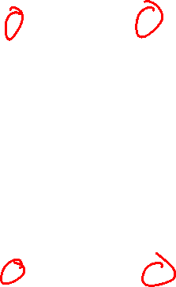
Where We Are
1
1
b¹
b²
Feed-Forward Neural Network
Initialize Weights
Y₁
X₁
Y₂
X₂
W¹
W²

Slide 135
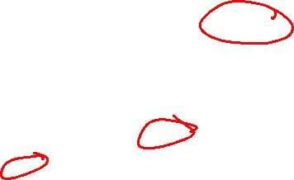
Where We Are
1
1
b¹
b²
Feed-Forward Neural Network
Initialize Weights
SGD loop (for random example):
forward propagate for activations
Y₁
X₁
C(Y₁,Y₂)
Y₂
X₂
a¹
W¹
W²
z³|a³
z²|a²

Slide 136

Where We Are
1
1
$$\frac{∂C}{∂b^{l}}$$
$$\frac{∂C}{∂b^{l}}$$
Feed-Forward Neural Network
Initialize Weights
SGD loop (for random example):
forward propagate for activations
backward propagate for derivatives
Y₁
X₁
C(Y₁,Y₂)
Y₂
X₂
a¹
$$\frac{∂C}{∂w^{1}}$$
$$\frac{∂C}{∂w^{2}}$$
z³|a³
z²|a²

Slide 137
Where We Are
1
1
b¹
b²
Feed-Forward Neural Network
Initialize Weights
SGD loop (for random example):
forward propagate for activations
backward propagate for derivatives
update weights
Y₁
X₁
Y₂
X₂
W¹
W²

Slide 138
Where We Are
1
1
b¹
b²
Feed-Forward Neural Network
Initialize Weights
SGD loop (for random example):
forward propagate for activations
backward propagate for derivatives
update weights
-1
-1
$${\begin{aligned}\text{δ}\text{=16 ∗ 1} \\ \text{δ}=16\end{aligned}}^{}$$
-1
-1
Z=0
a=0
1
1
Y₁
z=4
a=4
X₁
-1
-2
-1
2
-3
z=1
a=1
1
$${\begin{aligned}\text{δ}\text{=16 ∗ 0 } \\ \text{δ}=0\end{aligned}}^{}$$
Cost
16
1
-1
2
Y₂
z=-4
a=0
X₂
1
3
z=2
a=2
-1
3
W¹
W²
$${\text{δ}}^{L}={\text{▽}}_{a^{L}}\text{C}\text{ ⊙} g′(z^{L})$$

Slide 139
Outstanding Issues with Neural Networks
Starting Values
Standard SGD Issues – Local vs. Global Minimum
Stopping Point

Slide 140
Neural Networks – Initializing Weights
1
1
b¹
b²
Initialize with all 0s?
0
0
0
0
Y₁
X₁
0
0
0
0
0
0
0
0
0
0
Y₂
X₂
0
0
0
W¹
W²

Slide 141
Neural Networks – Initializing Weights
1
1
b¹
b²
Initialize with all 0s?
Locks Up
Initialize with all 1s?
Y₁
X₁
Y₂
X₂
W¹
W²

Slide 142
Neural Networks – Initializing Weights
1
1
b¹
b²
Initialize with all 0s?
Locks Up
Initialize with all 1s?
Works fine…
Initialize with small random weights?
Y₁
X₁
Y₂
X₂
W¹
W²

Slide 143
Neural Networks – Initializing Weights
1
1
b¹
b²
Initialize with all 0s?
Locks Up
Initialize with all 1s?
Works fine…
Initialize with small random weights?
Works fine…
Y₁
X₁
Y₂
X₂
W¹
W²

Slide 144

Neural Networks – Convex Function?
1
1
b¹
b²
Local vs. Global Minimum?
What happens if I swap Y₁ and Y₂?
Y₁
X₁
Y₂
X₂
W¹
W²

Slide 145
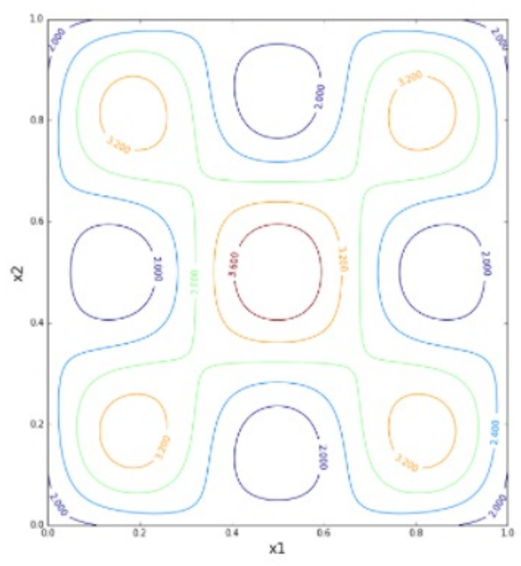

Neural Networks – Convex Function?
1
1
b¹
b²
Local vs. Global Minimum?
Y₁
X₁
Y₂
X₂
W¹
W²

Slide 146

Neural Networks – Overcoming Local Minimum
Multiple training iterations
Initialize with different random variables
Add a noise term to weights
Weights fluctuate even without gradient
Momentum
Increase weight adjustment rate
1
1
b¹
b²
Y₁
X₁
Y₂
X₂
W¹
W²

Slide 147
Neural Networks – Initializing Weights
1
1
b¹
b²
Initialize with all 0s?
Locks Up
Initialize with all 1s?
Works fine…
Initialize with small random weights?
Works better…
Y₁
X₁
Y₂
X₂
W¹
W²

Slide 148
Neural Networks – Weight Explosions
1
1
b¹
b²
How do we combat weights growing out of control?
Y₁
X₁
Y₂
X₂
W¹
W²

Slide 149
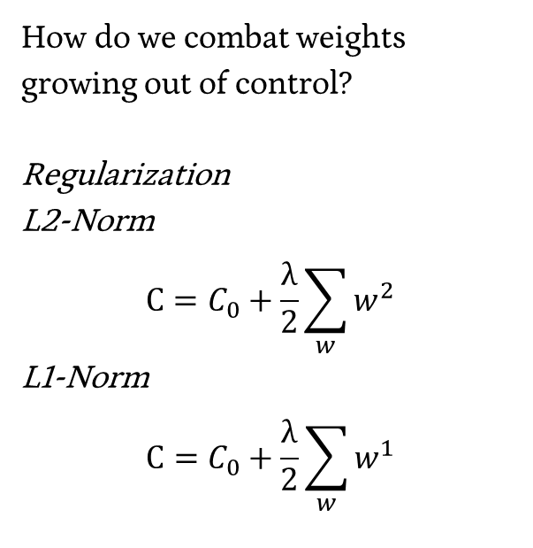
Neural Networks – Weight Explosions
1
1
b¹
b²
How do we combat weights growing out of control?
Regularization
L2-Norm
$$C=C_{0}+\frac{\text{λ}}{2}\sum_{w}{w^{2}}$$
L1-Norm
$$C=C_{0}+\frac{\text{λ}}{2}\sum_{w}{w^{1}}$$
Y₁
X₁
Y₂
X₂
W¹
W²

Slide 150
Neural Networks – Stopping Point
1
1
b¹
b²
Y₁
X₁
Y₂
X₂
W¹
W²

Slide 151
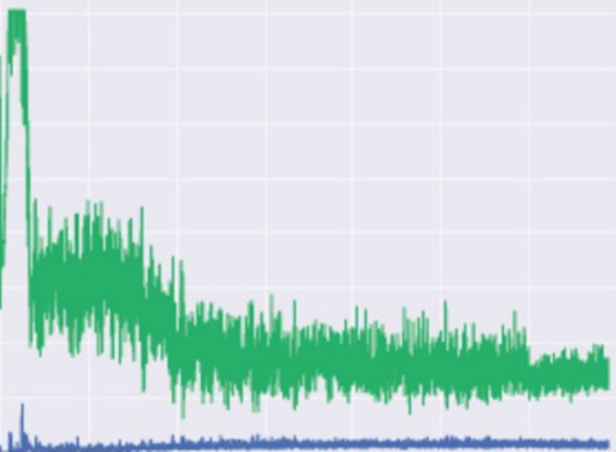
Neural Networks – Stopping Point
1
1
b¹
b²
Same as any SGD Problem, stop when accuracy on validation set stops improving, or at some sort of threshold.
Y₁
X₁
Y₂
X₂
W¹
W²

Slide 152
Convolutional Neural Networks

Slide 153
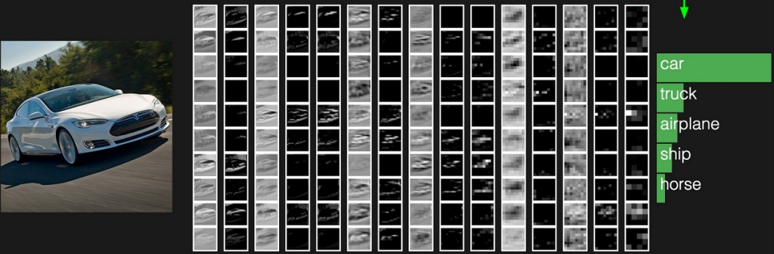
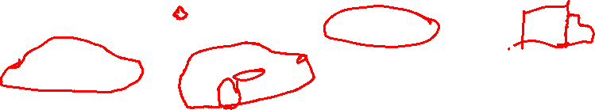
Neural Network – Object Recognition

Slide 154
Basic Feed-Forward Neural Networks
1
1
b¹
b²
Every element of a layer is connected to every element of the following layer
Y₁
X₁
Y₂
X₂
W¹
W²

Slide 155
Basic Feed-Forward Neural Networks
1
1
b¹
b²
Every element of a layer is connected to every element of the following layer
Ordering, neighboring doesn’t matter…
Y₁
X₁
Y₂
X₂
W¹
W²

Slide 156
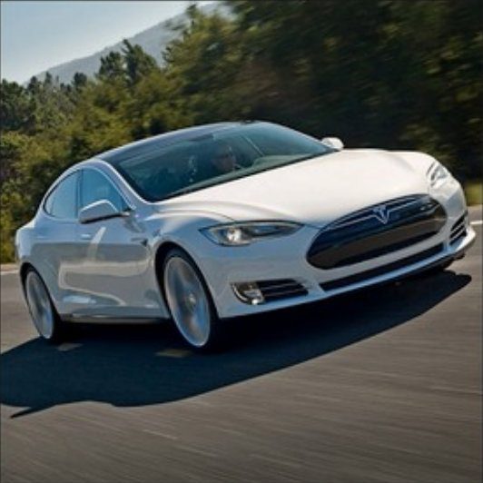

Slide 157
Convolution – CV in 15 minutes
Mathematically combining nearby info
Found in Signals Processing / Computer Vision

Slide 158

Convolution
Initial Matrix
20 | 20 | 45 | 200
18 | 20 | 125 | 240
35 | 125 | 245 | 245
145 | 250 | 240 | 240

Slide 159
Convolution
Initial Matrix
Convolution Matrix
20 | 20 | 45 | 200
18 | 20 | 125 | 240
35 | 125 | 245 | 245
145 | 250 | 240 | 240
1 | 0 | 1
0 | 1 | 0
1 | 0 | 1

Slide 160
Convolution
Initial Matrix
Convolution Matrix
20 | 20 | 45 | 200
18 | 20 | 125 | 240
35 | 125 | 245 | 245
145 | 250 | 240 | 240
1 | 0 | 1
0 | 1 | 0
1 | 0 | 1

Slide 161
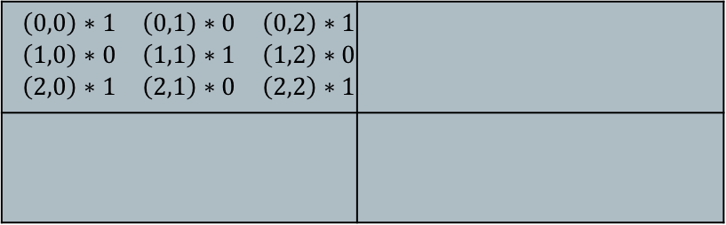
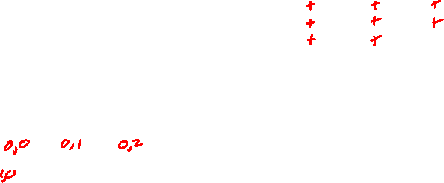
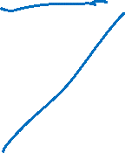
Convolution
Initial Matrix Output Matrix
Convolution Matrix
20 | 20 | 45 | 200
18 | 20 | 125 | 240
35 | 125 | 245 | 245
145 | 250 | 240 | 240
$$\begin{matrix}\left(0,0\right)∗1 & \left(0,1\right)∗0 & \left(0,2\right)∗1 \\ \left(1,0\right)∗0 & \left(1,1\right)∗1 & \left(1,2\right)∗0 \\ \left(2,0\right)∗1 & \left(2,1\right)∗0 & \left(2,2\right)∗1\end{matrix}$$
1 | 0 | 1
0 | 1 | 0
1 | 0 | 1

Slide 162
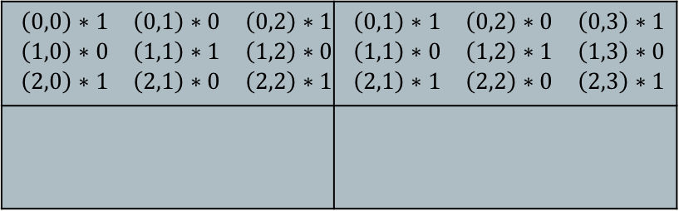
Convolution
Initial Matrix Output Matrix
Convolution Matrix
20 | 20 | 45 | 200
18 | 20 | 125 | 240
35 | 125 | 245 | 245
145 | 250 | 240 | 240
$$\begin{matrix}\left(0,0\right)∗1 & \left(0,1\right)∗0 & \left(0,2\right)∗1 \\ \left(1,0\right)∗0 & \left(1,1\right)∗1 & \left(1,2\right)∗0 \\ \left(2,0\right)∗1 & \left(2,1\right)∗0 & \left(2,2\right)∗1\end{matrix}$$ | $$\begin{matrix}\left(0,1\right)∗1 & \left(0,2\right)∗0 & \left(0,3\right)∗1 \\ \left(1,1\right)∗0 & \left(1,2\right)∗1 & \left(1,3\right)∗0 \\ \left(2,1\right)∗1 & \left(2,2\right)∗0 & \left(2,3\right)∗1\end{matrix}$$
1 | 0 | 1
0 | 1 | 0
1 | 0 | 1

Slide 163
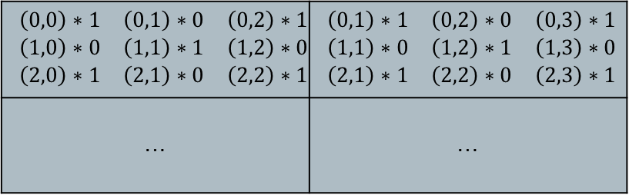

Convolution
Initial Matrix Output Matrix
Convolution Matrix
20 | 20 | 45 | 200
18 | 20 | 125 | 240
35 | 125 | 245 | 245
145 | 250 | 240 | 240
$$\begin{matrix}\left(0,0\right)∗1 & \left(0,1\right)∗0 & \left(0,2\right)∗1 \\ \left(1,0\right)∗0 & \left(1,1\right)∗1 & \left(1,2\right)∗0 \\ \left(2,0\right)∗1 & \left(2,1\right)∗0 & \left(2,2\right)∗1\end{matrix}$$ | $$\begin{matrix}\left(0,1\right)∗1 & \left(0,2\right)∗0 & \left(0,3\right)∗1 \\ \left(1,1\right)∗0 & \left(1,2\right)∗1 & \left(1,3\right)∗0 \\ \left(2,1\right)∗1 & \left(2,2\right)∗0 & \left(2,3\right)∗1\end{matrix}$$
… | …
1 | 0 | 1
0 | 1 | 0
1 | 0 | 1

Slide 164
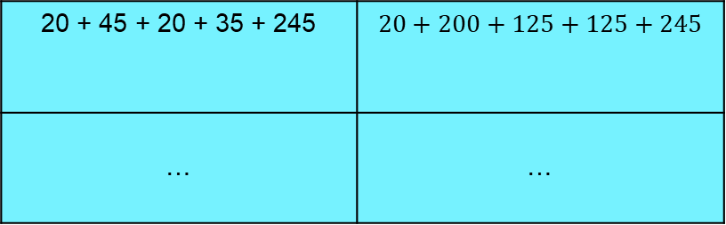

Convolution
20 | 20 | 45 | 200
18 | 20 | 125 | 240
35 | 125 | 245 | 245
145 | 250 | 240 | 240
1 | 0 | 1
0 | 1 | 0
1 | 0 | 1
$$\text{20 + 45 + 20 + 35 + 245}$$ | $$20+200+125+125+245$$
… | …

Slide 165
Convolution Matrices
Binary, e.g. diagonal Random
Intentional e.g. sombrero / hat
1 | 0 | 1
0 | 1 | 0
1 | 0 | 1
1 | -2 | 5
-3 | 1 | .4
-1.7 | -4 | 3
1 | 1 | 1
1 | -5 | 1
1 | 1 | 1

Slide 166
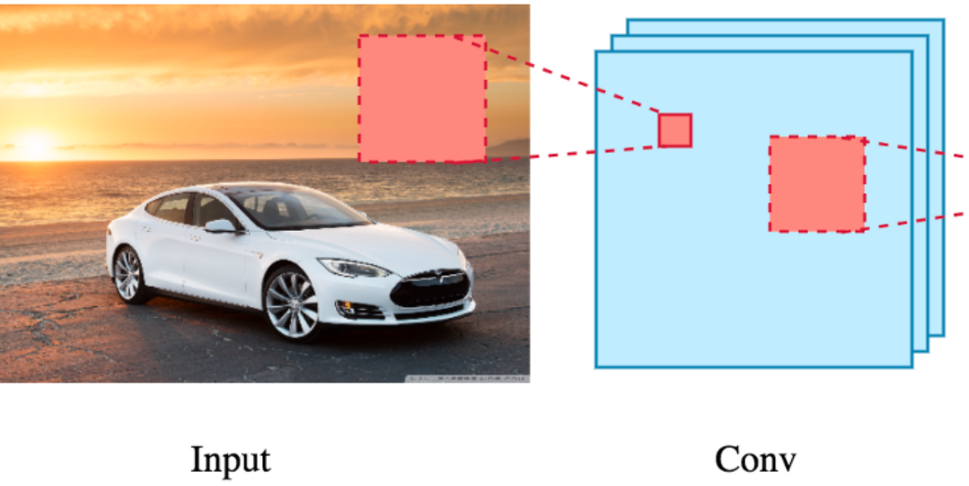
Data Convolution

Slide 167
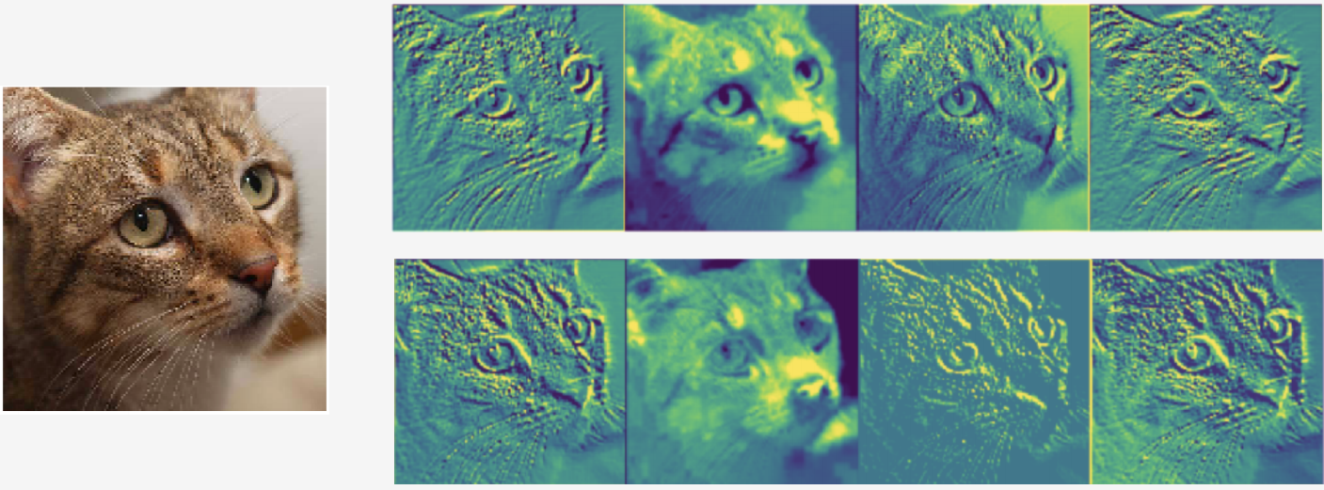
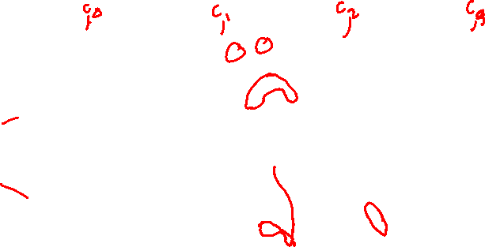
Data Convolution
First Layer Convolutions

Slide 168
Pooling
Reduce Complexity by combining neighboring terms
20 | 20 | 45 | 200
18 | 20 | 125 | 240
35 | 125 | 245 | 245
145 | 250 | 240 | 240

Slide 169

Pooling
Reduce Complexity by combining neighboring terms
e.g. max pool
20 | 20 | 45 | 200
18 | 20 | 125 | 240
35 | 125 | 245 | 245
145 | 250 | 240 | 240
20 | 240
250 | 245

Slide 170
Pooling
Reduce Complexity by combining neighboring terms
e.g. max pool
Downsamples the image (to reduce complexity)
Allow neighboring features to interact (grow downstream receptive fields)
20 | 20 | 45 | 200
18 | 20 | 125 | 240
35 | 125 | 245 | 245
145 | 250 | 240 | 240
20 | 240
250 | 245

Slide 171
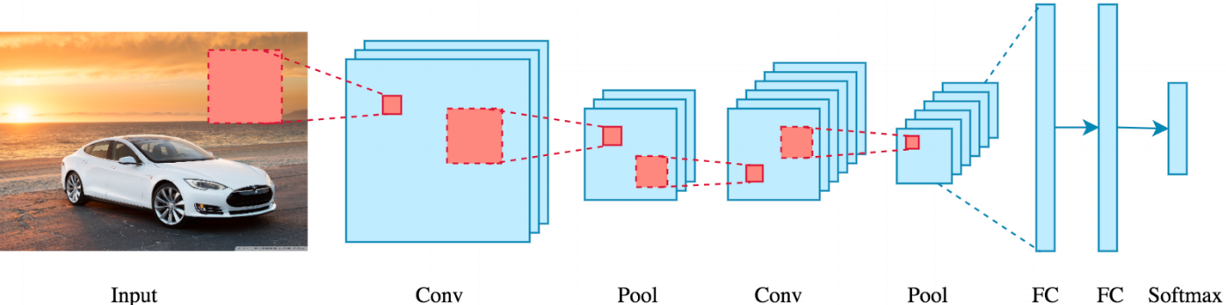

Convolution + Pooling

Slide 172
Improving Convolutions
SGD with Back Propagation
Details of implementation are beyond this course

Slide 173
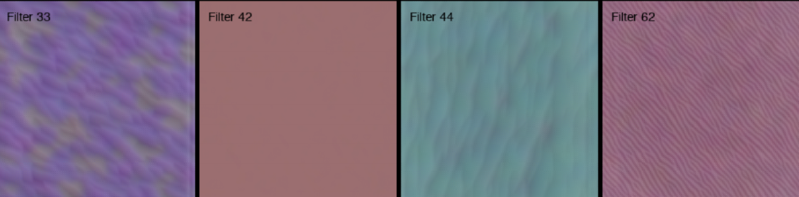

Convolution + Pooling – Multiple Iterations
Convolution Layer 1

Slide 174
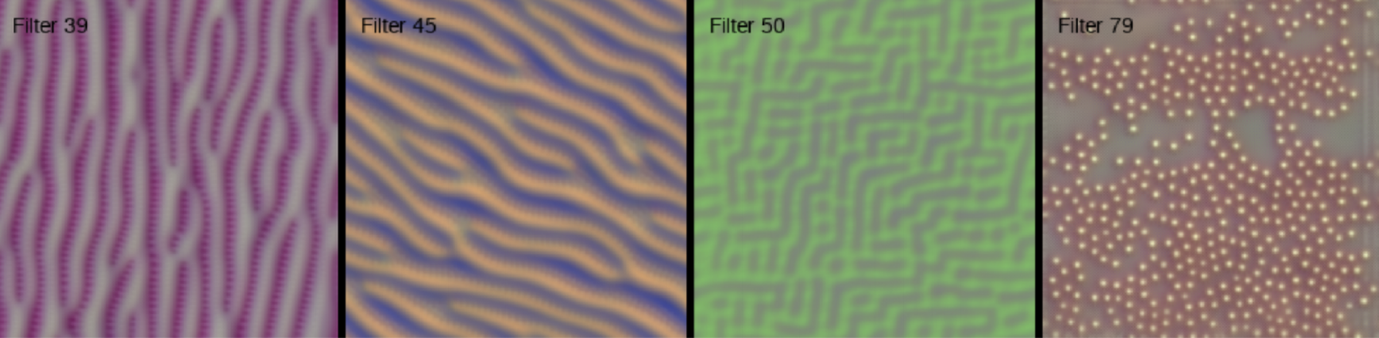
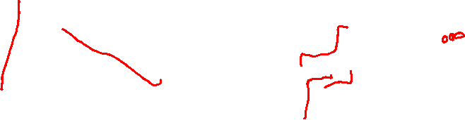
Convolution + Pooling – Multiple Iterations
Convolution Layer 2

Slide 175
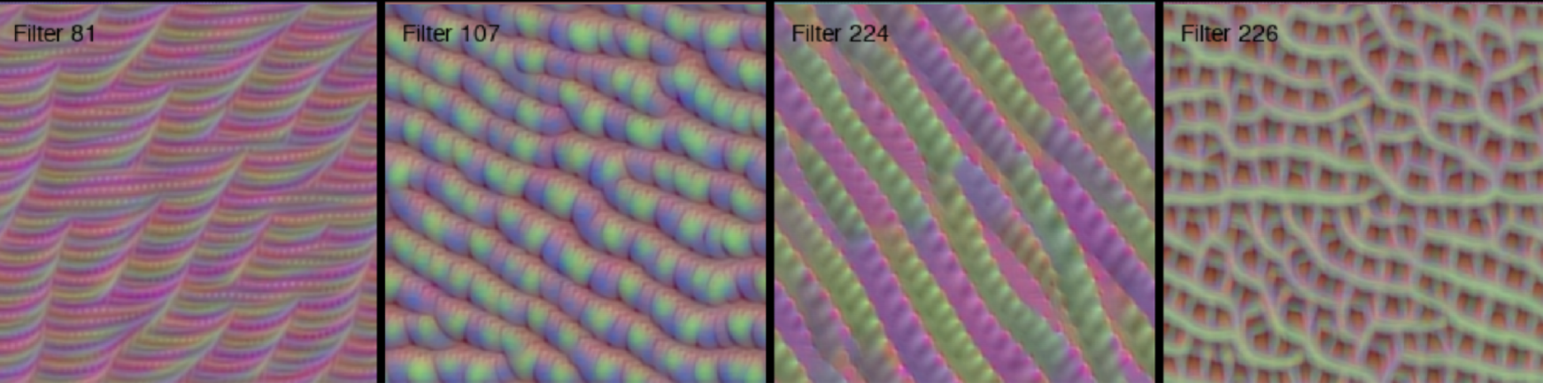
Convolution + Pooling – Multiple Iterations
Convolution Layer 3

Slide 176
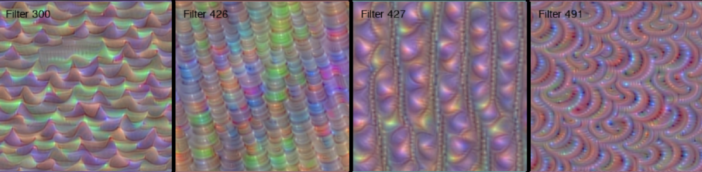
Convolution + Pooling – Multiple Iterations
Convolution Layer 4

Slide 177
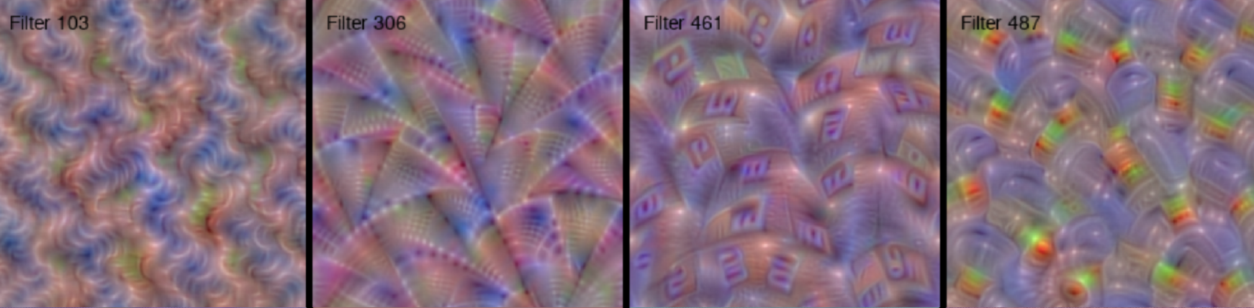

Convolution + Pooling – Multiple Iterations
Convolution Layer 5

Slide 178
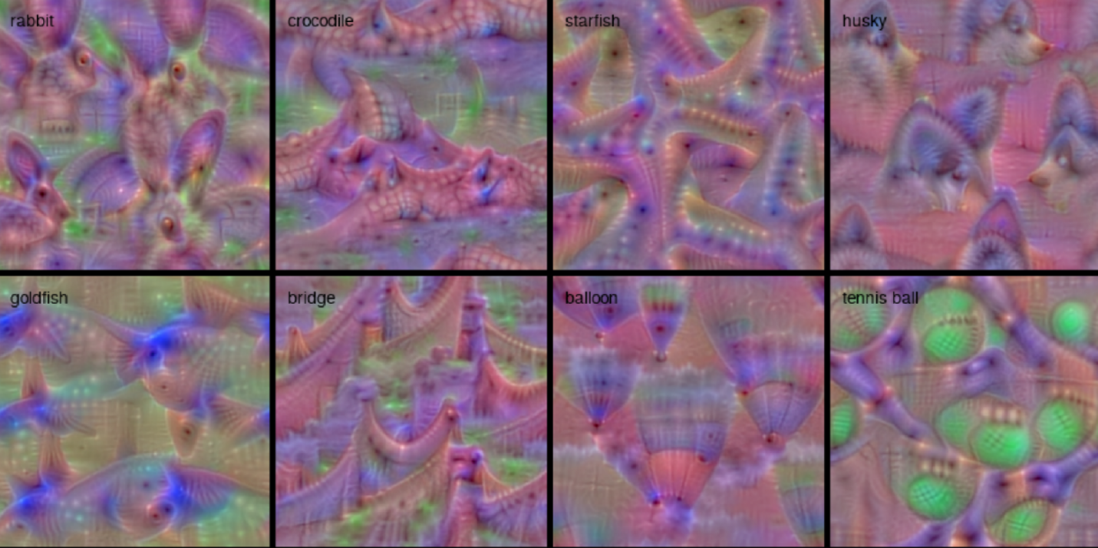
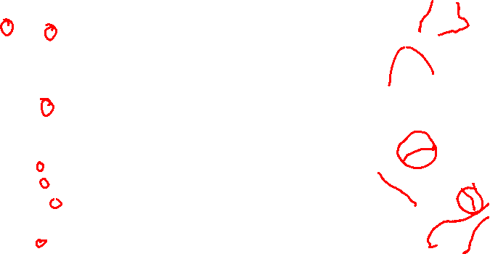
Convolution + Pooling – Multiple Iterations
Convolution Results

Slide 179

Convolutional Neural Network
Captures grid structure – retains it through layers

Slide 180

CNNs - Applications
Music – Genre Prediction

Slide 181

CNNs - Applications
NLP – Sentence Classification

Slide 182
More Complex Analysis
Useful Information for PS3 and PS4

Slide 183


Side² Note: Feature Scaling vs. Normalizing

Slide 184
Min-Max Scaling
Transform X (Data) to X’ (Scaled Data)
For (x_{i}) in X
scale = max(x_{i}) – min(x_{i})
For (x_{i,j}) in (x_{i})
x’_{i,j} = (x_{i,j} – min(x_{i})) / scale

Slide 185
Z-Score Normalization
Transform X (Data) to X’ (Normalized Data)
For (x_{i}) in X
mean = mean(x_{i})
dev = stdev(x_{i})
For (x_{i,j}) in (x_{i})
x’_{i,j} = (x_{i,j} – mean) / dev
https://en.wikipedia.org/wiki/Feature_scaling

Slide 186
Normalization with Splits
Train Data
Hold-Out Data
How should we work through scaling and / or normalization
with splits?
Test Data

Slide 187

Normalization with Splits
Train Data
Hold-Out Data
Test Data
What are these data splits really modeling?
Training Set:
Test Set:
Hold-Out (inner validation) Set:

Slide 188
Normalization with Splits
Train Data
Hold-Out Data
Test Data
What are these data splits really modeling?
Training Set: The data we have seen before – things we can train on.
Test Set: The data we have never seen before – things we have no way of knowing, and therefore no way of training on.
Hold-Out (inner validation) Set: Things we are treating like a Test set for internal validation processes (optimizing tuning parameters, etc.)

Slide 189
Normalization with Splits
Train Data
Hold-Out Data
Test Data
Which pieces can we use to set our parameters for normalization?

Slide 190
Normalization with Splits
Train Data
Hold-Out Data
Test Data
Which pieces can we use to set our parameters for normalization?
Only the training set!

Slide 191
Normalization with Splits
Train Data
Hold-Out Data
Test Data
Which pieces can we use to set our parameters for normalization?
Only the training set!
How are we going to transform our Hold-Out Data and Test Data so that they are normalized to look like our Train Data?

Slide 192
Normalization with Splits
Train Data
Hold-Out Data
Test Data
Which pieces can we use to set our parameters for normalization?
Only the training set!
How are we going to transform our Hold-Out Data and Test Data so that they are normalized to look like our Train Data?
Only by using the parameters of our training set normalization!

Slide 193

Caveat: Problem Set 3

Slide 194
Caveat: Problem Set 3
It’s asking you to center X for both normalized and un-normalized!
But also use the un-centered X for the Bias terms…

Slide 195
Caveat: Problem Set 3
It’s asking you to center X for both normalized and un-normalized!
But also use the un-centered X for the Bias terms…
Some of the “sanity check” tests differ in whether they’re expecting centered or uncentered values…

Slide 196
Types of Errors
Classified As Ground Truth | C | ~C
C | True Positive (Hit) | False Negative (Miss)
~C | False Positive (False Alarm) | True Negative (Correct Rejection)

Slide 197

Types of Errors
Accuracy = TP + TN / (all cells)
Classified As Ground Truth | C | ~C
C | True Positive (Hit) | False Negative (Miss)
~C | False Positive (False Alarm) | True Negative (Correct Rejection)

Slide 198
Errors
Skewed Classes
- Classifying a day of sun in Yuma, AZ (308 sunny days / year)
my classifier - isSunny = true
84 % Accuracy
- What if it’s a case with 98% in one class?
Is 98.5% accuracy helpful?
Are all errors created equal?

Slide 199

Types of Errors
Predicted Positive Rate (Precision) = Hits / (Hits + False Alarm)
Classified As Ground Truth | C | ~C
C | True Positive (Hit) | False Negative (Miss)
~C | False Positive (False Alarm) | True Negative (Correct Rejection)

Slide 200

Types of Errors
True Positive Rate (Sensitivity, Recall) = Hits / (Hits + Miss)
Classified As Ground Truth | C | ~C
C | True Positive (Hit) | False Negative (Miss)
~C | False Positive (False Alarm) | True Negative (Correct Rejection)

Slide 201
Types of Errors
F₁ Score = 2 * ((precision*recall) / (precision + recall))
Classified As Ground Truth | C | ~C
C | True Positive (Hit) | False Negative (Miss)
~C | False Positive (False Alarm) | True Negative (Correct Rejection)

Slide 202
Types of Errors
F₁ Score = TP / (TP + .5(FP+FN))
Classified As Ground Truth | C | ~C
C | True Positive (Hit) | False Negative (Miss)
~C | False Positive (False Alarm) | True Negative (Correct Rejection)

Slide 203
Reinforcement Learning
How to learn everything in one lecture*

Slide 204
Reinforcement Learning in One Class
IMPOSSIBLE!
There are books on the subject
- Reinforcement Learning: An Introduction – Sutton & Barto
- http://incompleteideas.net/book/the-book.html

Slide 205
Our Typical ML Models
Fitting our Model to Training Data
- Fitting Decision Boundary
- Finding weights, biases, etc.
- Finding Similar Examples

Slide 206

A Different Kind of Problem…
Notes:
https://assetstorev1-prd-cdn.unity3d.com/key-image/3887a860-dbac-447f-8358-732a955e0e19.jpg

Slide 207

A Different Kind of Problem…
Notes:
http://incompleteideas.net/book/bookdraft2017nov5.pdf

Slide 208
A Different Kind of Problem…
Complex decisions
Multi-step activity
steps are not independent
Multiple (Opposing) Players
Notes:
https://assetstorev1-prd-cdn.unity3d.com/key-image/3887a860-dbac-447f-8358-732a955e0e19.jpg

Slide 209
Examples of this Problem
Games – board (chess, go, others), video (adventure, strategy, others)
Stock Investing
Autonomous Vehicles
Others…

Slide 210
Defining Our Problem Space
Agent – A decision-making entity

Slide 211
Defining Our Problem Space
Agent – A decision-making entity
Environment – The space in which the Agent is making decisions

Slide 212

Defining Our Problem Space
Agent – A decision-making entity
Environment – The space in which the Agent is making decisions
State – The current status of the Environment

Slide 213

Defining Our Problem Space
Agent – A decision-making entity
Environment – The space in which the Agent is making decisions
State – The current status of the Environment
Goal – An eventual outcome sought by the Agent

Slide 214

Defining Our Problem Space
Agent – A decision-making entity
Environment – The space in which the Agent is making decisions
State – The current status of the Environment
Goal – An eventual outcome sought by the Agent
Reward – An intermediate measure of success / failure towards the Goal

Slide 215

Defining Our Problem Space
Agent – A decision-making entity
Environment – The space in which the Agent is making decisions
State (S) – The current status of the Environment
Goal – An eventual outcome sought by the Agent
Reward (R) – Intermediate measure of success/failure towards the Goal
Action (A) – The options available to the Agent to change the State

